Slide 1












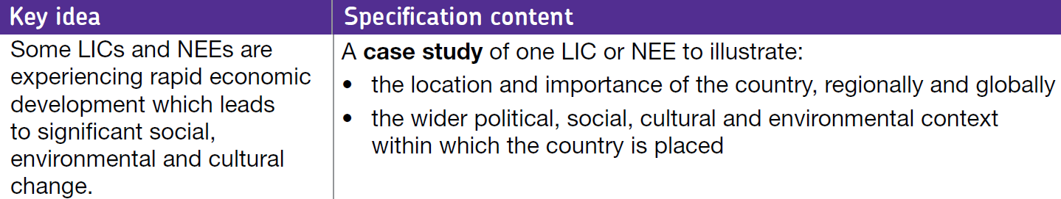
3.2 Challenges in the human environment
3.2.2 Section B: The changing economic world
Economic Development in Nigeria (an African NEE)
- Aid & Debt in Nigeria
Min. class time: 1 hour

Slide 2

I can help development, but what am I?!
International
aid
10 points: I appear to be generous, but I’m not always what I seem
7 points: There are many ways to give me out, I can be given out directly or shared out from a ‘bank’
5 points: I had a very famous Christmas song sung about me
3 points: I can be a life-saver in times of emergencies and natural disasters
2 points: Governments (usually HICs) and charities hand me out
1 point: Without my help, some countries would be unable to afford to pay for infrastructure (e.g. road networks), economic and social projects (e.g. new hospitals) on their own
Notes:
Slide from the “Reducing the development gap” 1st l

Slide 3
Types of aid: Bingo!
Choose 6 of the following terms and put them in a 3x2 grid:
Official development assistance (ODA)
Multilateral aid
Bilateral aid
Voluntary aid
Short-term emergency aid
Long-term development aid
Bottom-up
Top-down
World Bank & International Monetary Fund (IMF)

Slide 4
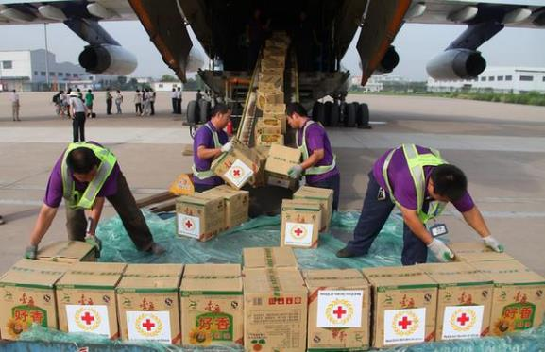
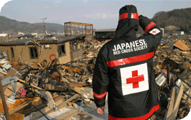
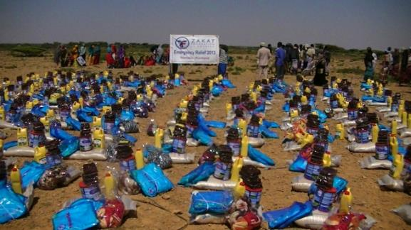
Helps cope with immediate problems caused by disasters, like earthquakes, disease outbreaks and wars…
Notes:
Short-term emergency relief

Slide 5
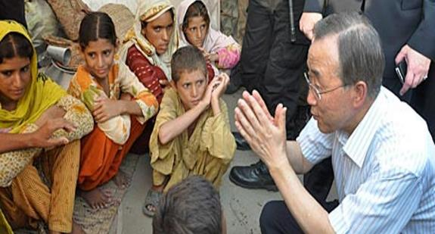
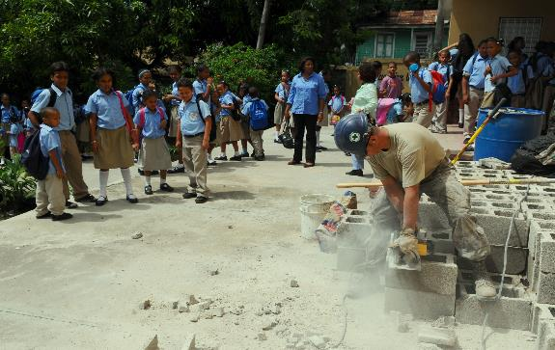
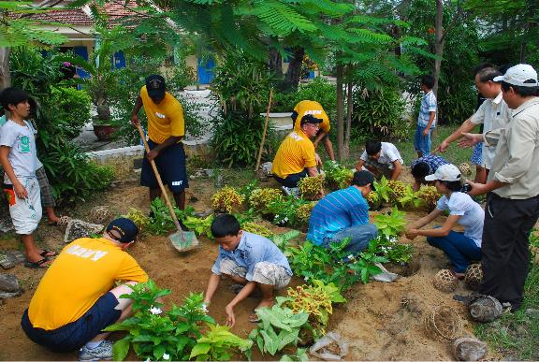
Money is given directly to local people e.g. WaterAid trains local people to maintain village handpumps. Can have a large impact – schemes are generally supported by local people and can improve health, skills an income.
Notes:
“Bottom-up” aid

Slide 6


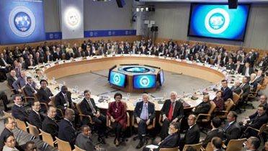
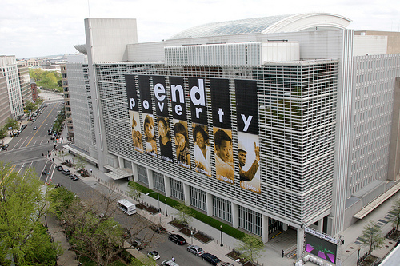
Institutions in the United Nations system. They share the same goal of raising living standards in their member countries. One focuses on macroeconomic issues and the other concentrating on long-term economic development and poverty reduction. However, the system they operate has faced many critics including richer nations which pay contributions to them. Some also say they make poverty worse, not better.
Notes:
World Bank & IMF - http://www.imf.org/en/About/Factsheets/Sheets/2016/07/27/15/31/IMF-World-Bank

Slide 7
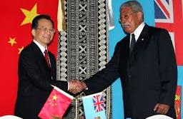
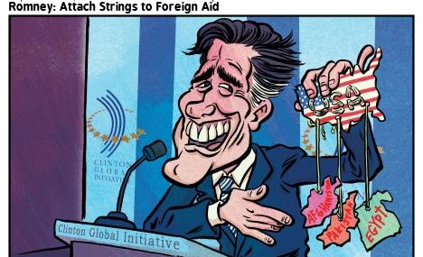
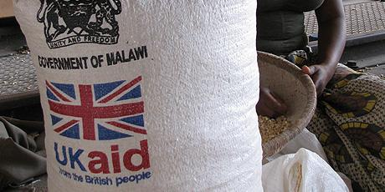
Aid which is given directly from one country to another. Sometimes it is “tied aid” with conditions attached. For example, the recipient may be required to buy goods from the donor country with the aid money.
Notes:
Bi-lateral aid

Slide 8


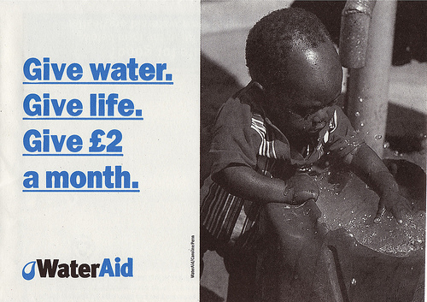
Given by individuals or companies and distributed through charities and non-governmental organisations (NGOs) like OXFAM.
Notes:
Voluntary aid

Slide 9
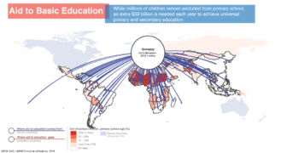
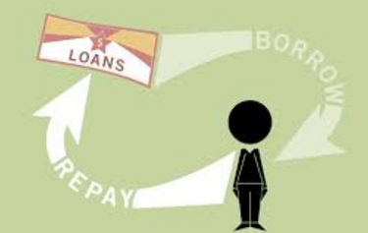
Given by countries through international organisations, like the World Bank or International Monetary Fund (IMF). These organisations then distribute help through aid and loans.
Notes:
Multilateral aid

Slide 10

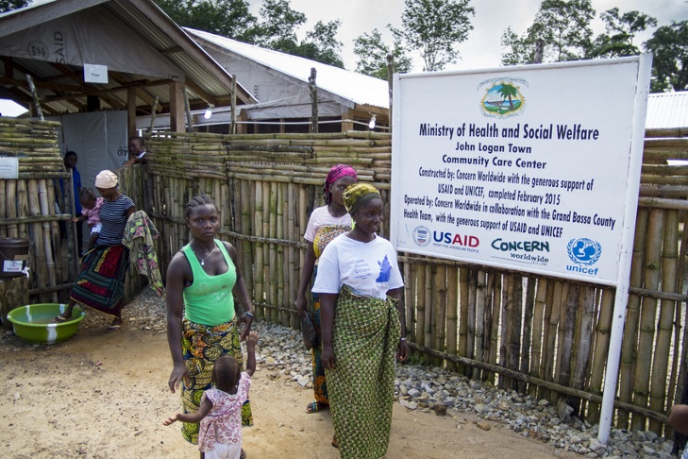
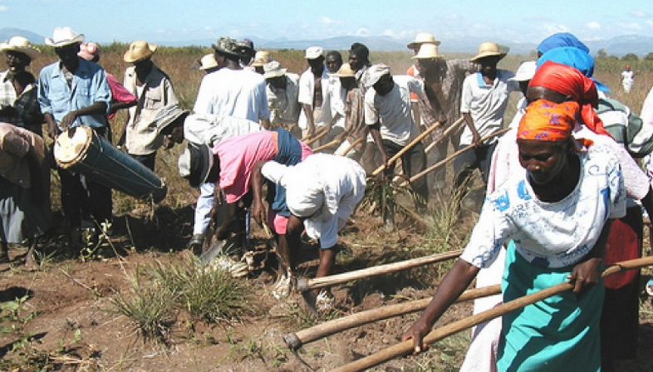
Helps people to improve their lives through education, healthcare or agricultural development.
Notes:
Long-term development aid

Slide 11
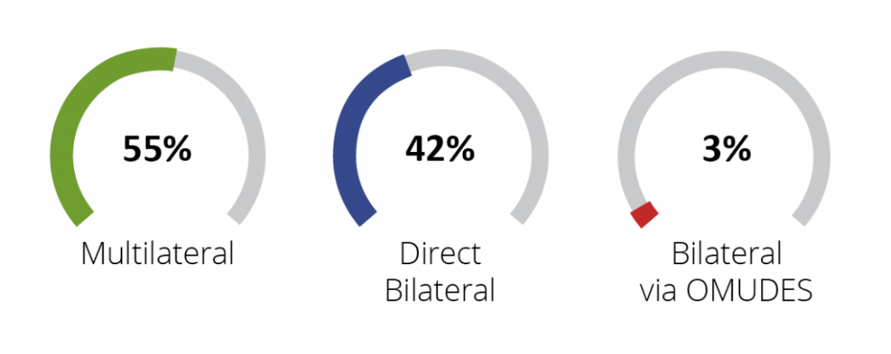
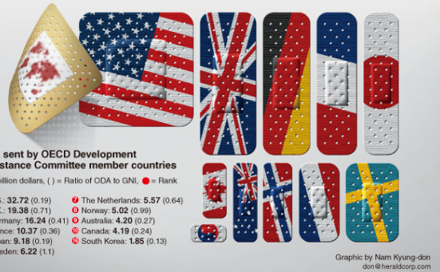
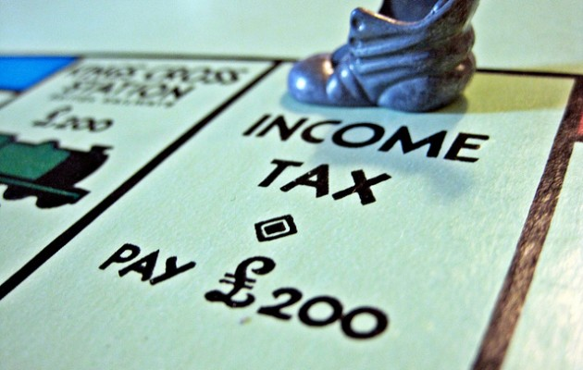
Given by governments and paid for by taxes. For this reason, it is sometimes unpopular with taxpayers in those countries.
Notes:
Official development assistance (ODA)

Slide 12
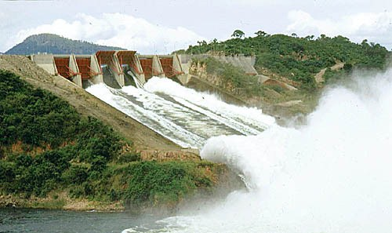
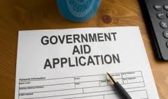
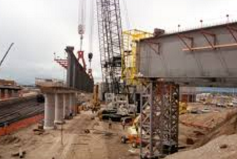
When an organisation or government receives the aid and decides where it should be spent. For example, large infrastructure projects like dams for hydroelectric or irrigation schemes. Can improve a country’s economy but may not improve the quality of life of the poorest people.
Notes:
Top-down aid

Slide 13
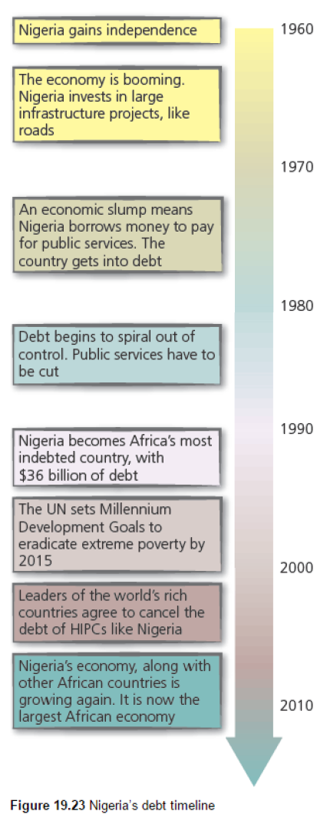
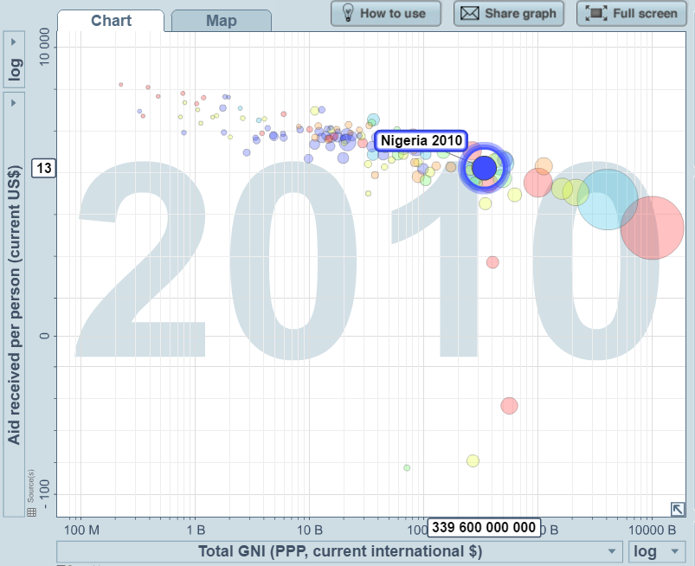
Does Nigeria still need aid?
Notes:
HIPC = Highly Indebted Poor Country. The amount of aid Nigeria receives, although it seems a lot, is actually in line with the pattern of the rest of the world, as this graph shows.

Slide 14
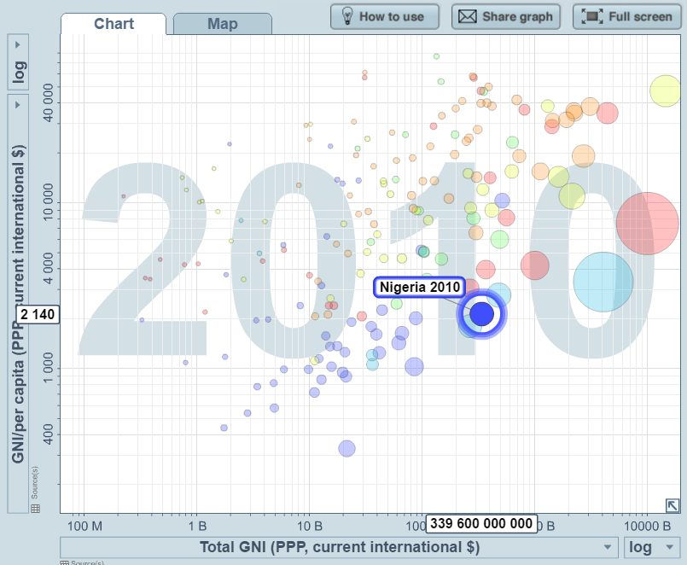
Does Nigeria still need aid?
Notes:
When you compare total GNI with GNI per capita (i.e. divide the wealth by population) you see that Nigeria comes out very poorly – one of the worst examples of a rich-poor divide in amongst all LICs/NEEs.

Slide 15
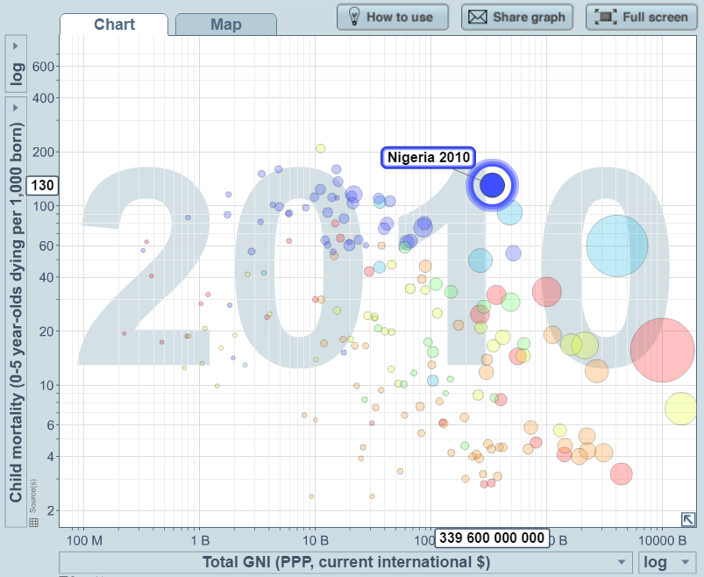
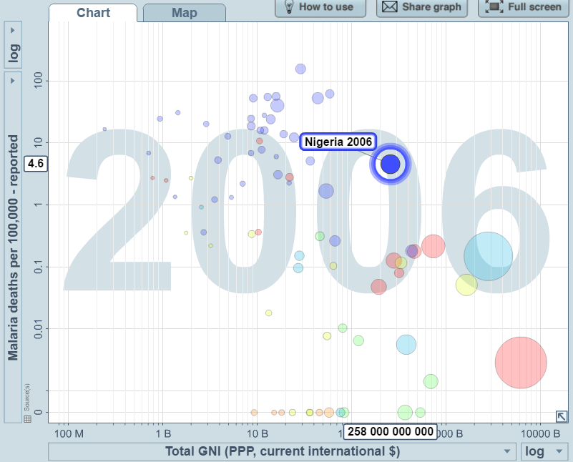
Does Nigeria still need aid?
Notes:
Both these graphs show that despite a high GNI, Nigeria doesn’t do at all well with Under-5 mortality and deaths per-1000 from malaria.

Slide 16
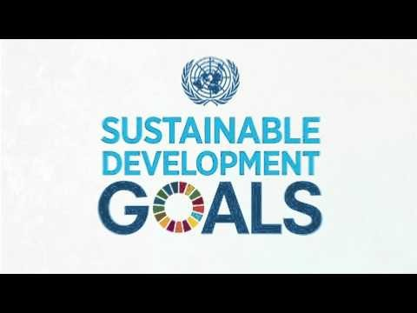
What are the Sustainable Development Goals?
Notes:
http://www.un.org/sustainabledevelopment/sustainable-development-goals/
https://www.youtube.com/watch?v=5_hLuEui6ww

Slide 17
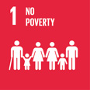

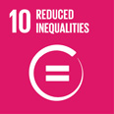
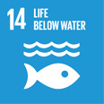
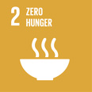

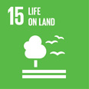




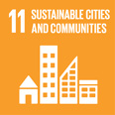





The SDGs - How is Nigeria doing?
% below poverty line (<$1.90/day)
1996: 63.5 2003: 53.5
2009: 53.5
% population w/ electricity
1990: 41.8 2010: 48.0
2015: 55.6
% undernourished
2001: 9.2 2009: 5.9
2016: 7.0
% unemployment
2010: 1.9 2012: 7.6
2014: 4.8
Not enough/no data
% land area forested
1990: 18.9 2005: 12.2
2015: 7.68
Under 5 mortality rate (per 1000)
2000: 187 2009: 136
2015: 109
% population covered by 2G
2002: 38.0 2009: 90.0
2014: 99.4
Unsentenced detainees
2005: 85.6%
2015: 69.6%
% pri teachers had basic training
2004: 59.8 2006: 61.6
2010: 71.7
% urban pop in slums
1990: 77.3 2005: 65.8
2014: 50.2
% who can use internet
2000: 0.06 2007: 6.77
2015: 47.7
% seats in parliament by women
2001: 3.4 2009: 7
2016: 5.56
Material footprint per capita
2000: 1.55 2005: 1.83
2010: 1.88 tonnes
% population w/ improved water
2000: 51.8 2009: 62.4
2015: 68.5
Risk strategy in place?
2013: No
2015: Yes

Slide 18
Priorities for aid?
% below poverty line (<$1.90/day)
1996: 63.5 2003: 53.5
2009: 53.5
% population w/ electricity
1990: 41.8 2010: 48.0
2015: 55.6
% undernourished
2001: 9.2 2009: 5.9
2016: 7.0
% unemployment
2010: 1.9 2012: 7.6
2014: 4.8
Not enough/no data
% land area forested
1990: 18.9 2005: 12.2
2015: 7.68
Under 5 mortality rate (per 1000)
2000: 187 2009: 136
2015: 109
% population covered by 2G
2002: 38.0 2009: 90.0
2014: 99.4
Unsentenced detainees
2005: 85.6%
2015: 69.6%
% pri teachers had basic training
2004: 59.8 2006: 61.6
2010: 71.7
% urban pop in slums
1990: 77.3 2005: 65.8
2014: 50.2
% who can use internet
2000: 0.06 2007: 6.77
2015: 47.7
% seats in parliament by women
2001: 3.4 2009: 7
2016: 5.56
Material footprint per capita
2000: 1.55 2005: 1.83
2010: 1.88 tonnes
% population w/ improved water
2000: 51.8 2009: 62.4
2015: 68.5
Risk strategy in place?
2013: No
2015: Yes
Notes:
Clicking will dim those of which are inconclusive or generally on target. Clicking again will keep those deemed a priority, perhaps, as they have a bigger impact on quality of life.

Slide 19
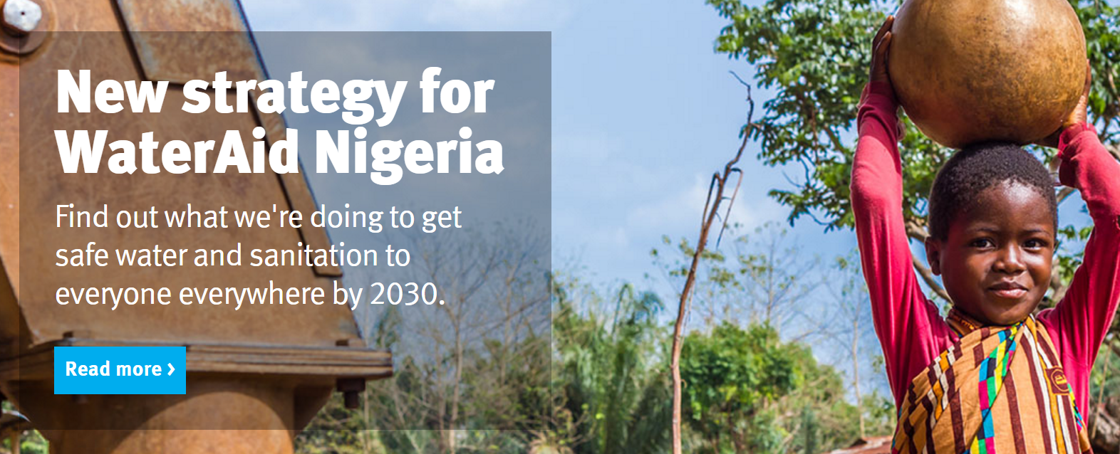
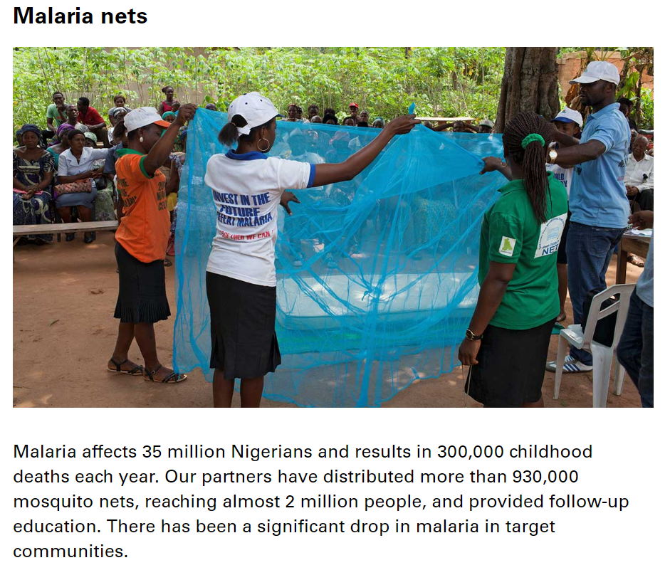

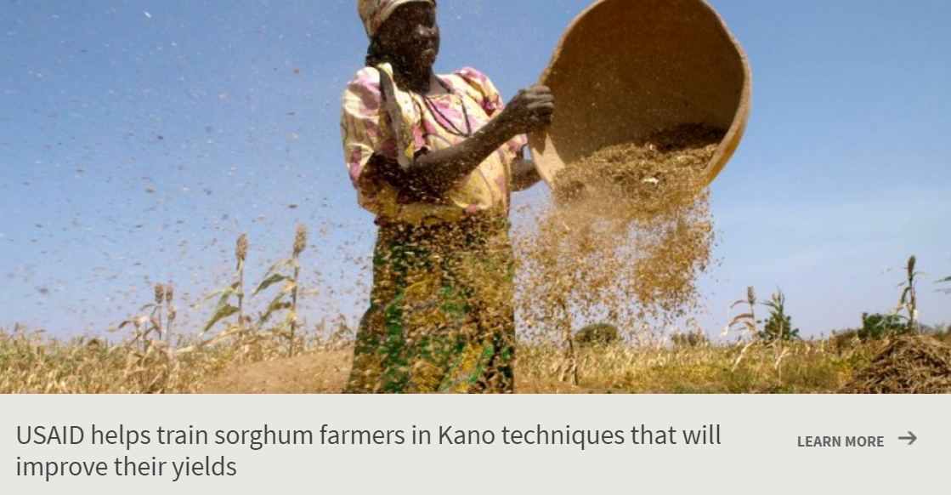
Some aid projects in Nigeria

Slide 20
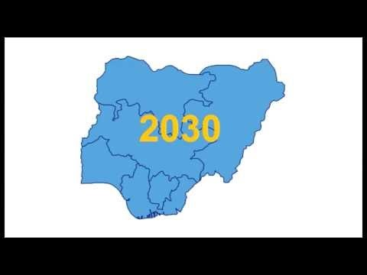

Quick questions:
What types of aid do these projects represent?
Which of the SDG can WaterAid help Nigeria to achieve?
Name three ways access to safe/improved water can help improve quality of life.
Briefly describe WaterAid’s new WASH strategy for Nigeria
% population w/ improved water
2000: 51.8 2009: 62.4
2015: 68.5
Notes:
NB: “WaSH” stands for Water, Sanitation and Hygiene

Slide 21
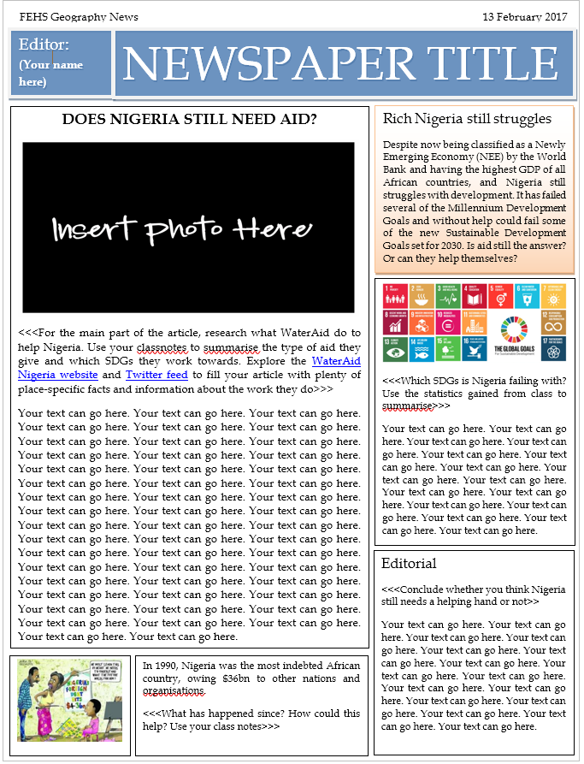
Homework
News article – Does Nigeria still need aid?
Use the news article frame on SMH to help structure your work.
You will need the information in the textbook, some videos (and your notes from today) as the sources of your information – all attached/linked on SMH.

