Slide 1













3.2 Challenges in the human environment
3.2.2 Section A: Urban issues and challenges
S.Rackley (FEHS Geog/NOAA Affiliate 2017)
Urban sustainability
- Ideas from the Solar Decathlon 2017
Min. focus time: 20 mins for objectives only (can be used as part of a lesson, homework or extra-curricular activity)
Notes:
Most text about the Decathlon has been adapted for summary and presentation purposes from https://www.solardecathlon.gov/2017/

Slide 2
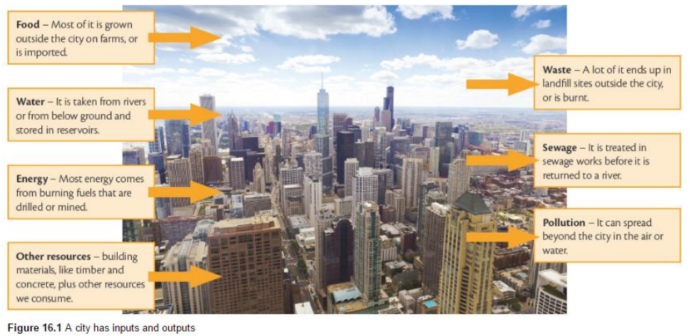
Problems/issues?

Slide 3
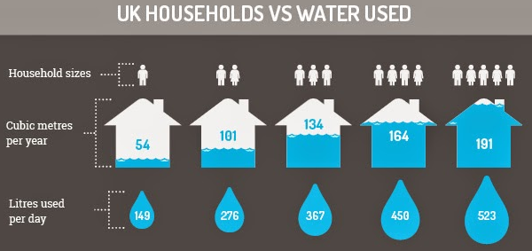
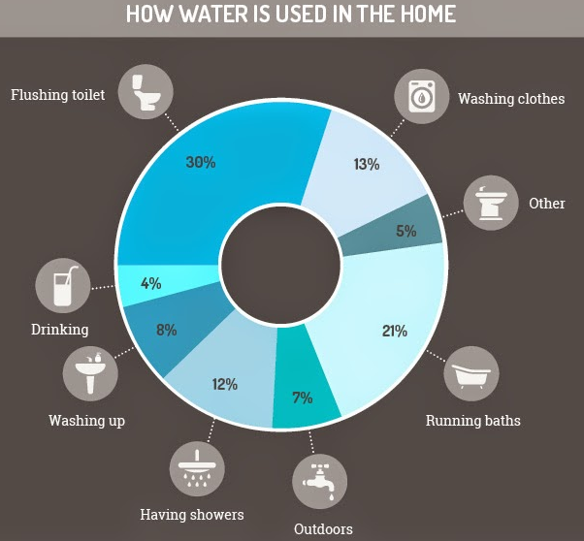
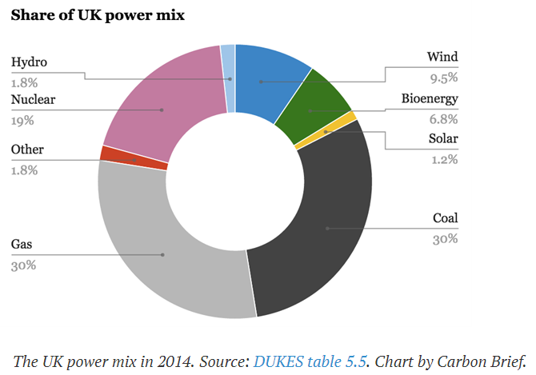
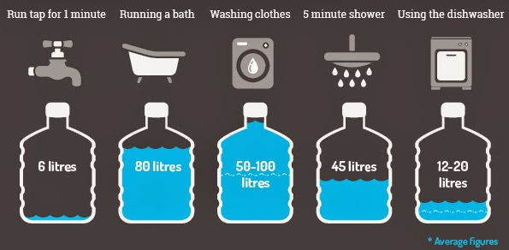
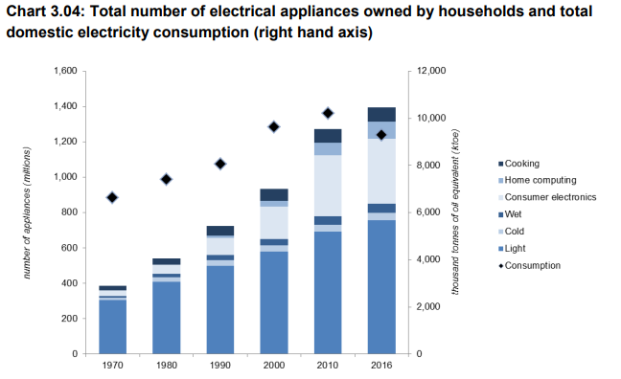
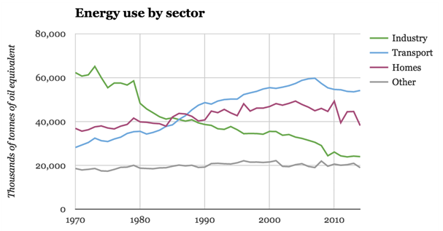
Water & Energy: UK Domestic Use
Notes:
Sources:
http://www.whererootsandwingsentwine.com/2015/01/water-usage-down-plughole-infographic.html (2015)
https://www.gov.uk/government/uploads/system/uploads/attachment_data/file/633503/ECUK_2017.pdf
https://www.carbonbrief.org/five-charts-show-the-historic-shifts-in-uk-energy-last-year

Slide 4
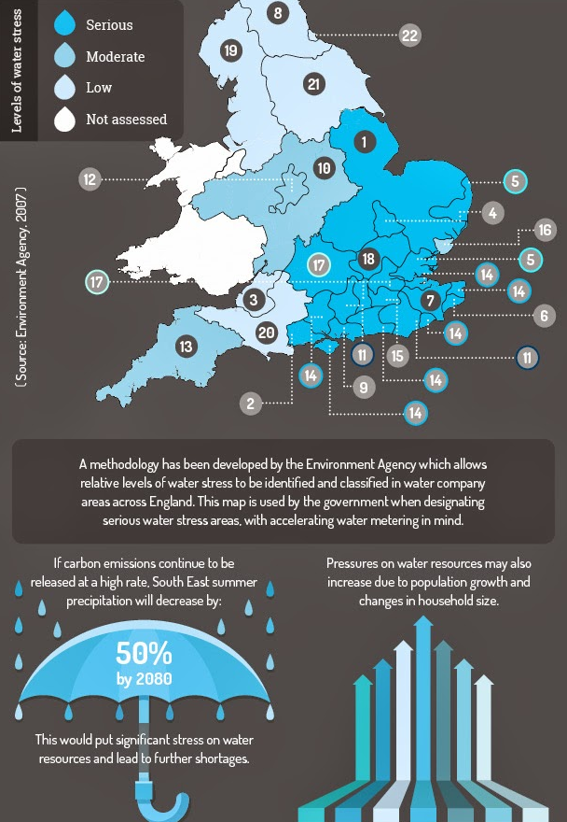
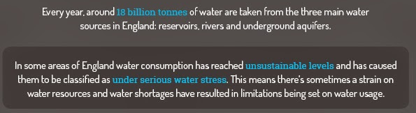
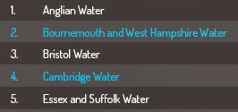


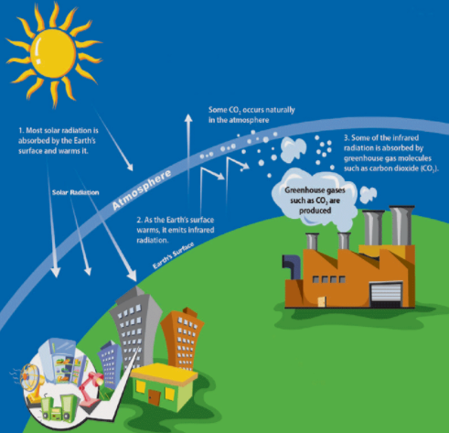
Why should we conserve water & energy?
<<<<< That’s us!
Also worth a look: http://www.showerbob.co.uk/userfiles/images/ShowerBoB%20Infographic.JPG
Notes:
Sources:
http://www.whererootsandwingsentwine.com/2015/01/water-usage-down-plughole-infographic.html (2015)
https://www.carbonbrief.org/energy-efficiency-policies-save-uk-homes-270-report-finds
http://www.e2singapore.gov.sg/About_E2PO/Why_Energy_Efficiency/Climate_Change_and_Energy_Efficiency.aspx
http://www.debatingeurope.eu/wp-content/uploads/2016/01/E4C-Energy-Security.jpg

Slide 5
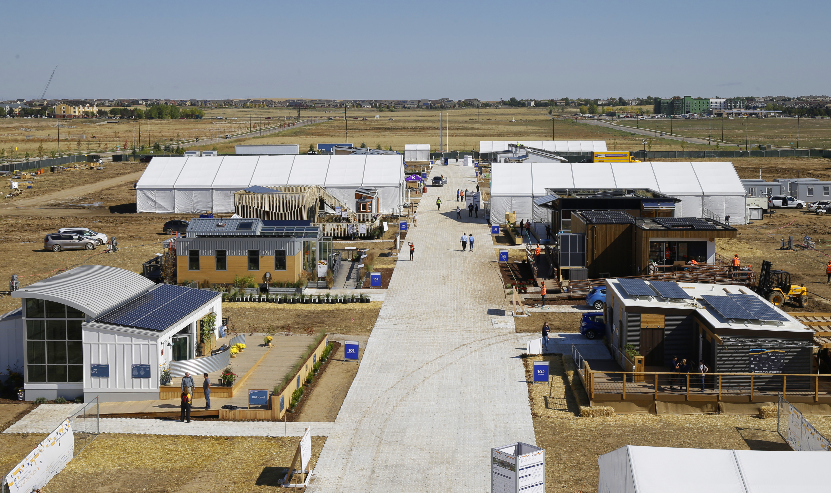


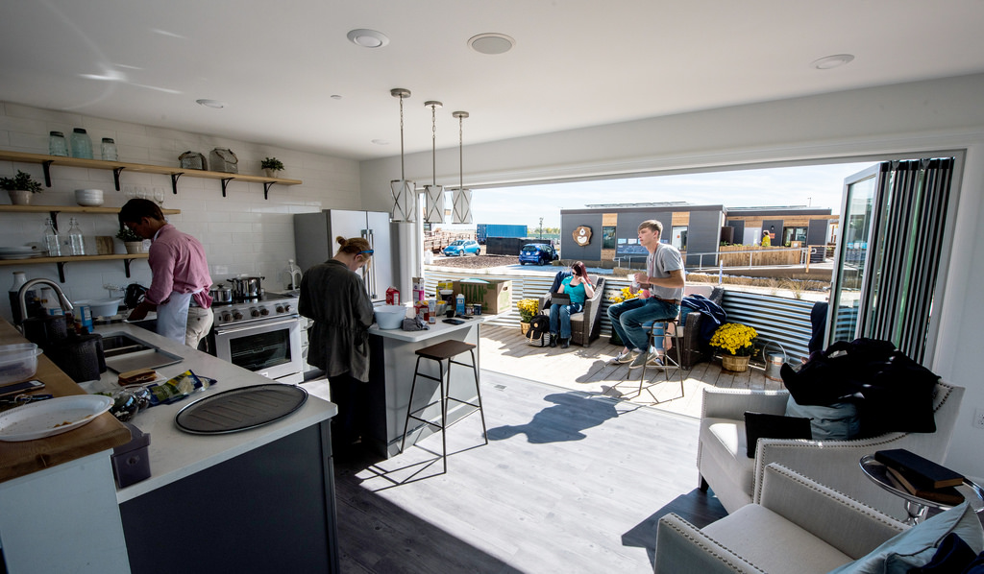
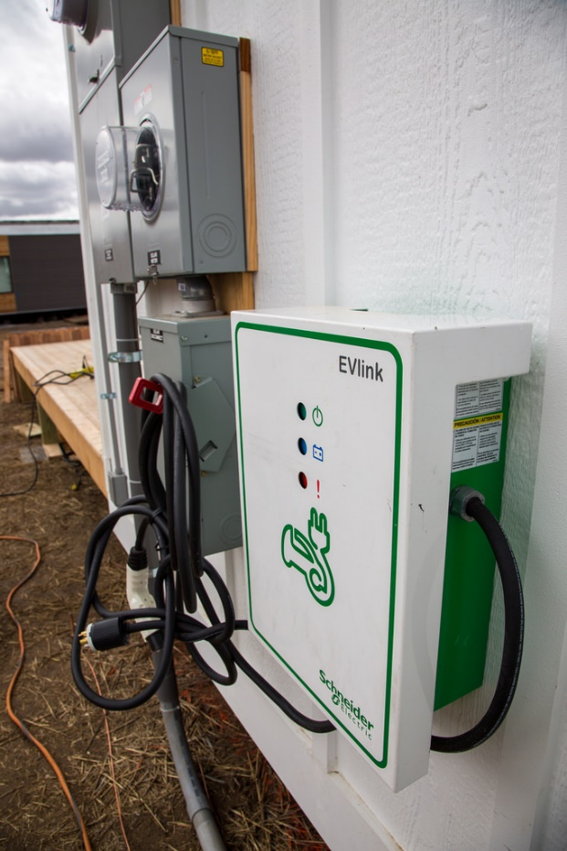
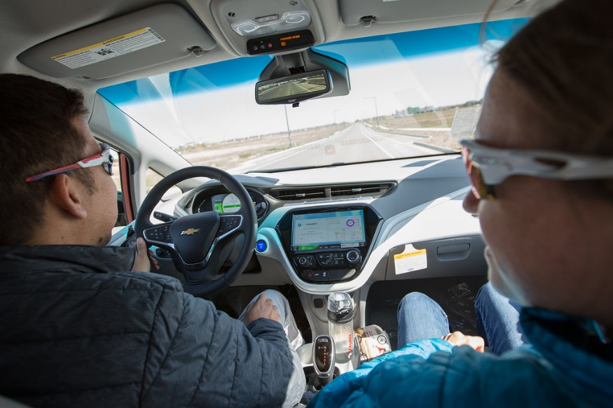
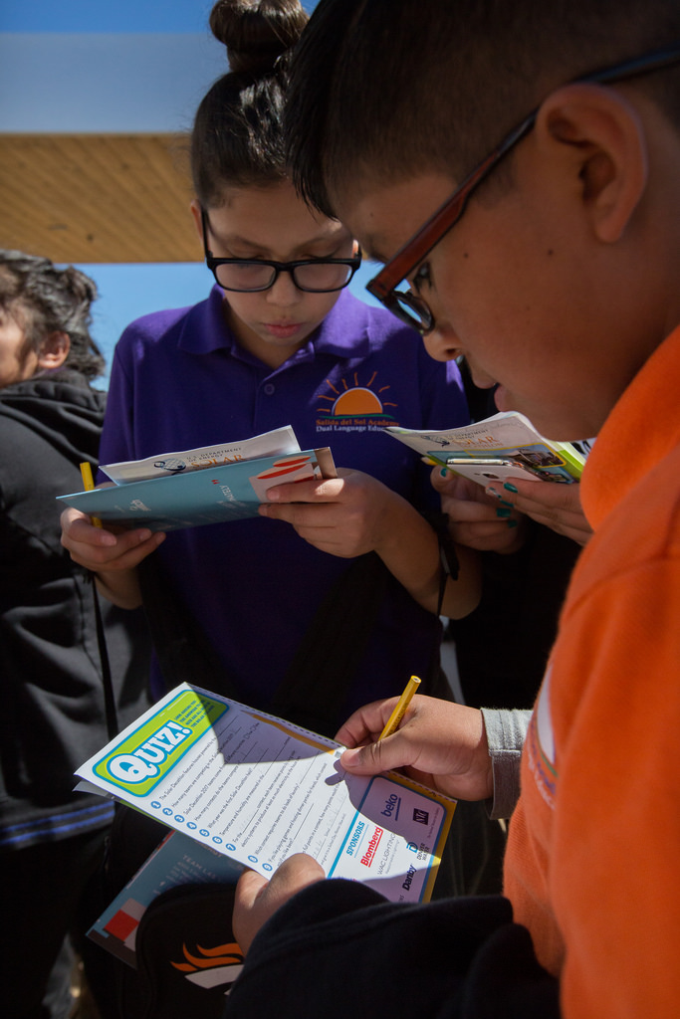
What is the Solar Decathlon?
Run by the United States Department of Energy the Solar Decathlon is a competition for university students made up of 10 contests that challenge student teams to design and build full-size, solar-powered houses. The winner of the competition is the team that best blends design excellence and smart energy production with innovation, market potential, and energy and water efficiency. It is held every two years; the 2017 competition took place in Denver, Colorado.
Click on a button to know more about each contest
= focuses on learning objectives
CLICK TO CONTINUE
Notes:
Photo credits: Jack Dempsey/U.S. Department of Energy Solar Decathlon (main photo); Denver International Airport/U.S. Department of Energy Solar Decathlon (EV charging point); Dennis Schroeder/U.S. Department of Energy Solar Decathlon (inside a house); John De La Rosa/U.S. Department of Energy Solar Decathlon (inside EV & school students) from https://www.solardecathlon.gov/2017/photos-event.html

Slide 6

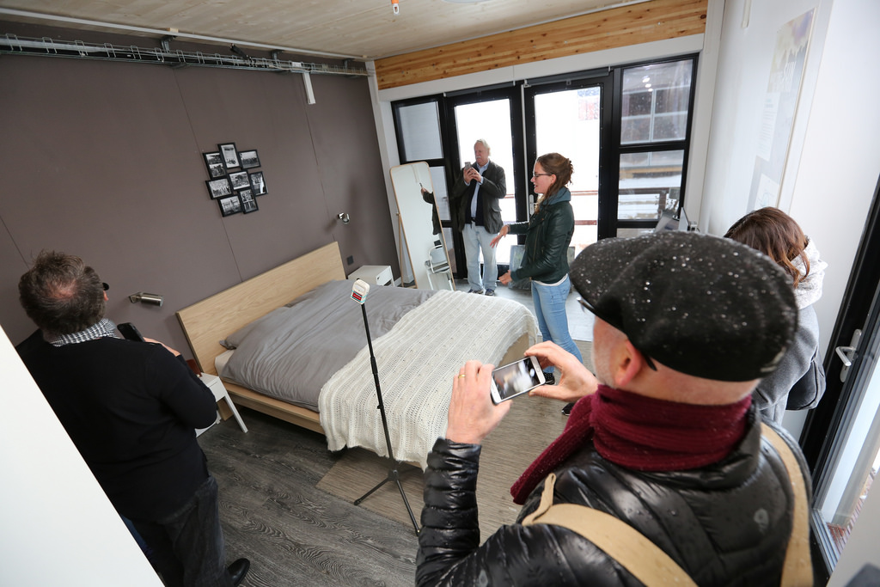
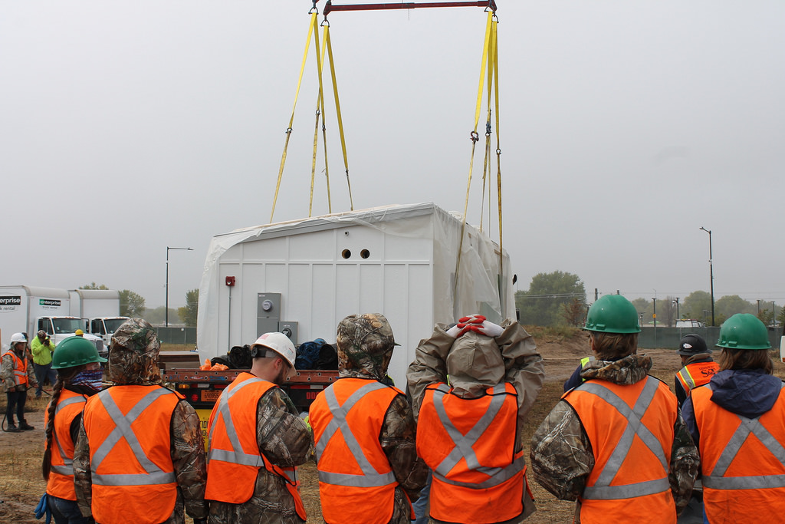
What is the Solar Decathlon?
ARCHITECTURE
For the Architecture Contest, teams were required to design and build attractive, high-performance houses that integrate solar and energy efficiency technologies seamlessly into the design.
A jury of architects will evaluated criteria regarding:
Architectural concept and design approach
Architectural implementation and innovation
Documentation, including use of photography and digital technology
Click on a button to know more about each contest
= focuses on learning objectives
CLICK TO CONTINUE
Notes:
Photo Credits: Missouri University of Science and Technology; Cody Williams/U.S. Department of Energy Solar Decathlon; John De La Rosa/U.S. Department of Energy Solar Decathlon

Slide 7
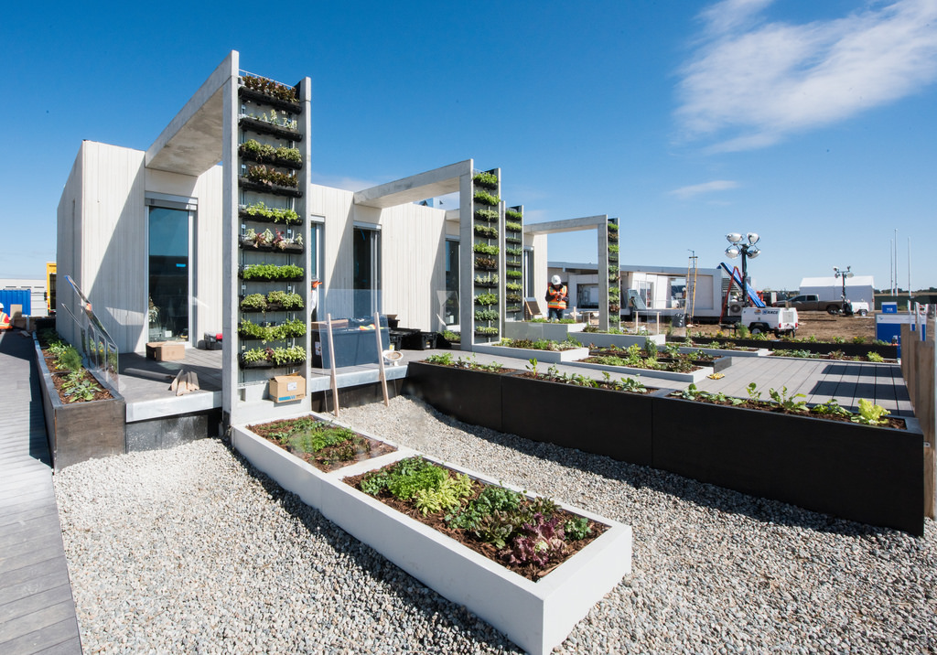
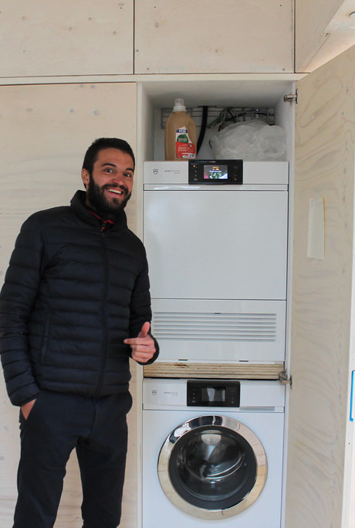
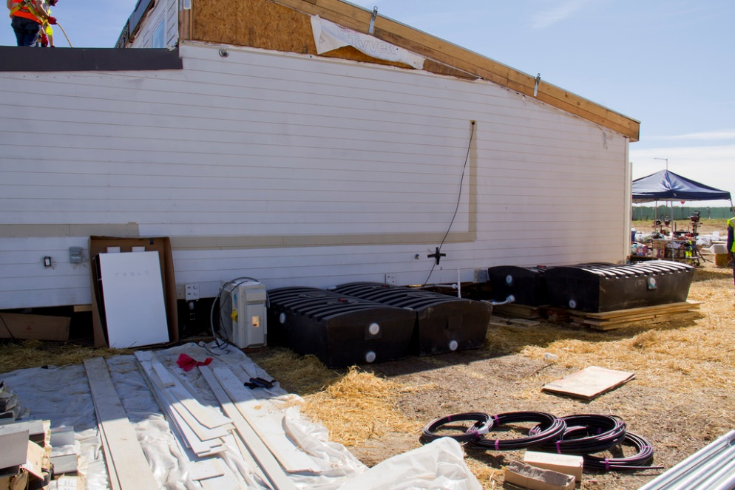
What is the Solar Decathlon?
WATER
Water and energy are inextricably linked—it takes water to make the energy we use, and it takes energy to treat and deliver the clean water we require. A jury of industry professionals evaluated each team's approach to water conservation, use, and reuse based on criteria such as:
Conservation
  To what extent will the house use less water than a comparable code-built house?
  How successfully does the design encourage a homeowner to reduce water use?
Reclamation and Reuse
  To what extent does the house reclaim and reuse water?
Landscaping
  To what extent does the design consider certain climate conditions?
  How successful is the design with regard to energy efficiency, maintenance, water runoff, and irrigation?
Click on a button to know more about each contest
= focuses on learning objectives
CLICK TO CONTINUE
Notes:
Photo credits: Dennis Schroeder/U.S. Department of Energy Solar Decathlon; Cody Williams/U.S. Department of Energy Solar Decathlon

Slide 8
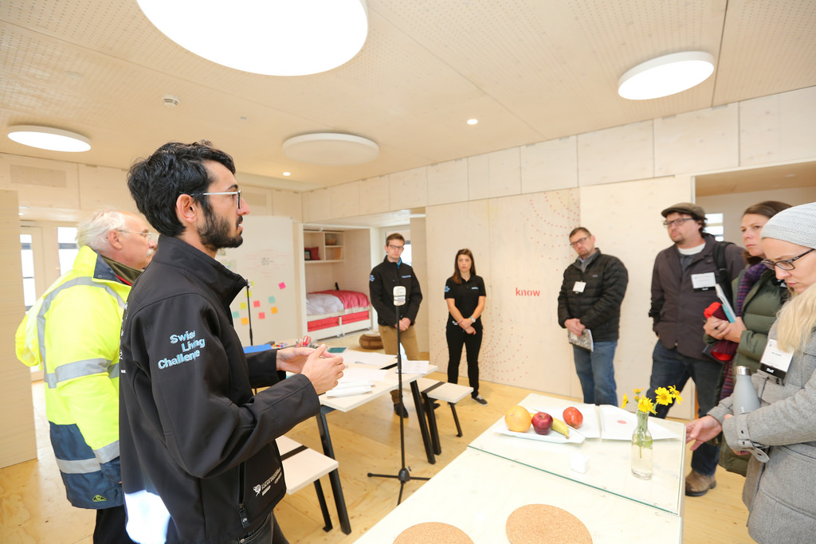
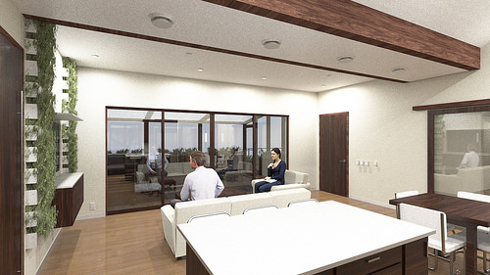
What is the Solar Decathlon?
MARKET POTENTIAL
Each team is required to design a primary residence for year-round occupancy for a specific target client of its choosing.
A jury of professionals from the homebuilding industry will evaluated the overall attractiveness of the design to the target client and the market impact potential of the house based on criteria regarding:
Market Potential
Livability
Cost Effectiveness
Buildability
Click on a button to know more about each contest
= focuses on learning objectives
CLICK TO CONTINUE
Notes:
Photo credits: John De La Rosa/U.S. Department of Energy Solar Decathlon; Northwestern University: Enable

Slide 9
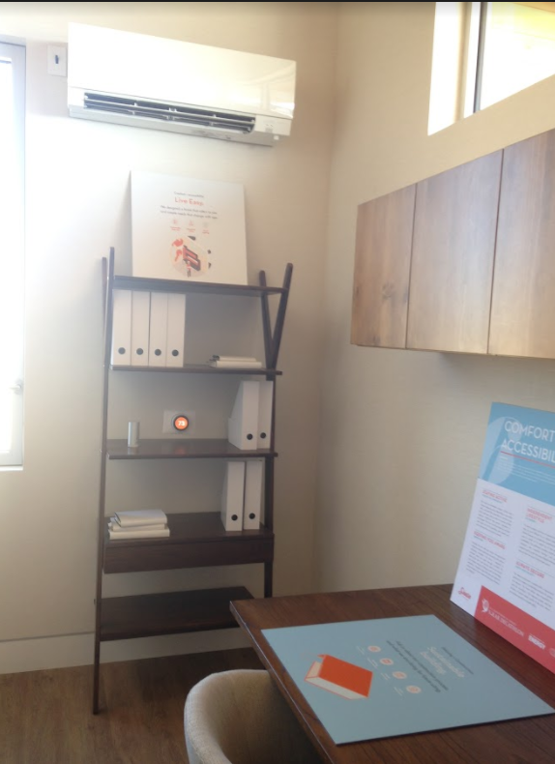
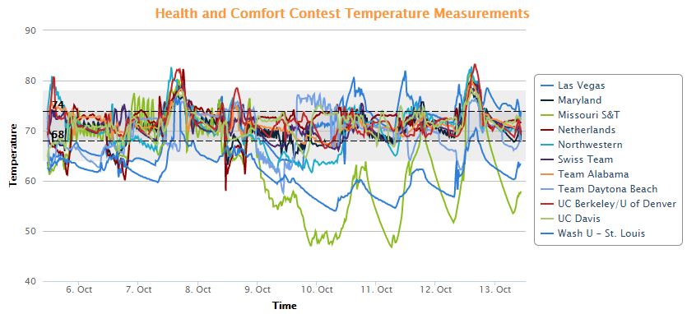
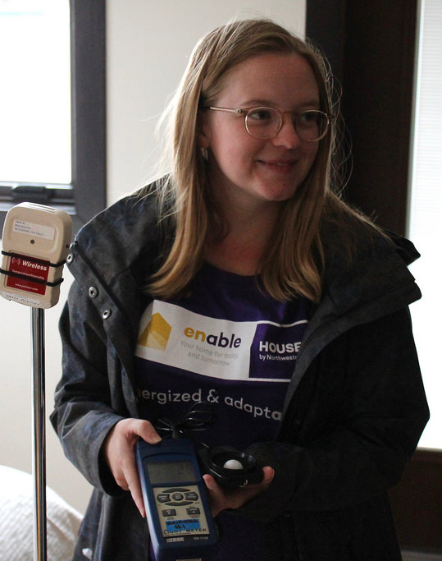
What is the Solar Decathlon?
HEALTH & COMFORT
Teams are challenged to build a house that minimizes the flow of cooled air in summer or heated air in winter to the outdoors, operate heating and cooling systems that keep temperature and humidity steady, all while maintaining healthy indoor air quality.
To earn full points for this contest, teams must maintain:
Temperatures between 68°F (20°C) and 74°F (23.3°C)
Relative humidity between 35% and 60%
Indoor CO₂ levels at less than 1,000 parts per million
A tight building envelope that minimizes airflow from the outside to the inside of the house and from the inside to the outside, thus reducing amount of energy required to heat or cool that air.
Click on a button to know more about each contest
= focuses on learning objectives
CLICK TO CONTINUE
Notes:
Photo credits: Steve Rackley; Cody Williams/U.S. Department of Energy Solar Decathlon;

Slide 10
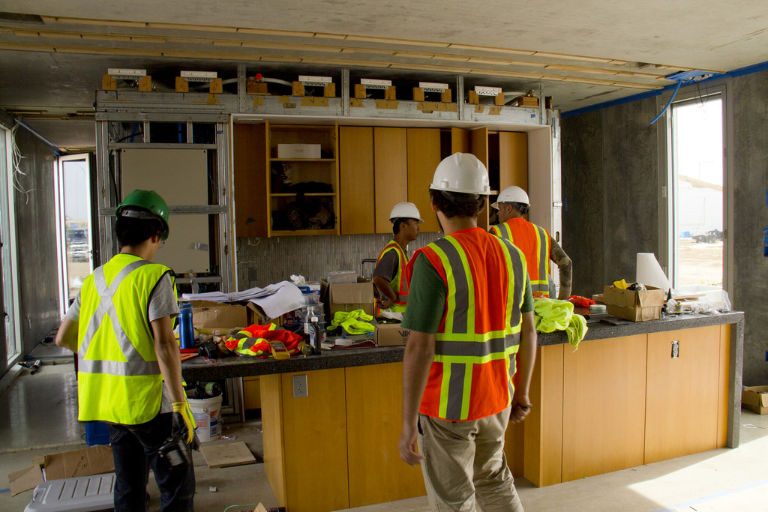
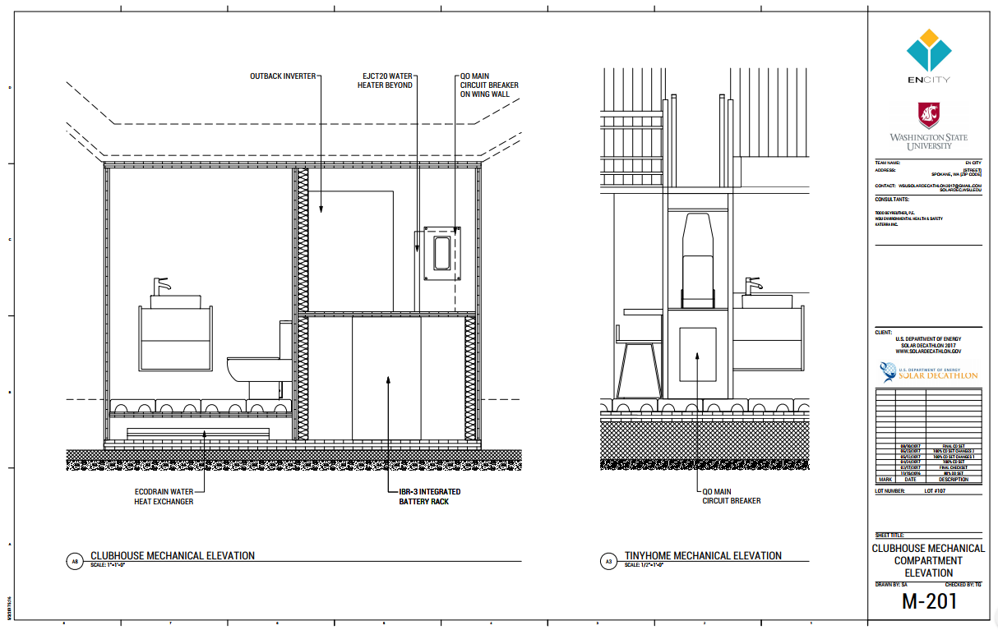
What is the Solar Decathlon?
ENGINEERING
Solar Decathlon houses are marvels of engineering. A jury of engineers evaluated the engineering design and implementation of each team's house based on criteria regarding:
Approach
Design
Efficiency
Performance
Documentation
Click on a button to know more about each contest
= focuses on learning objectives
CLICK TO CONTINUE
Notes:
Photo credits: Washington University; U.S. Department of Energy Solar Decathlon

Slide 11
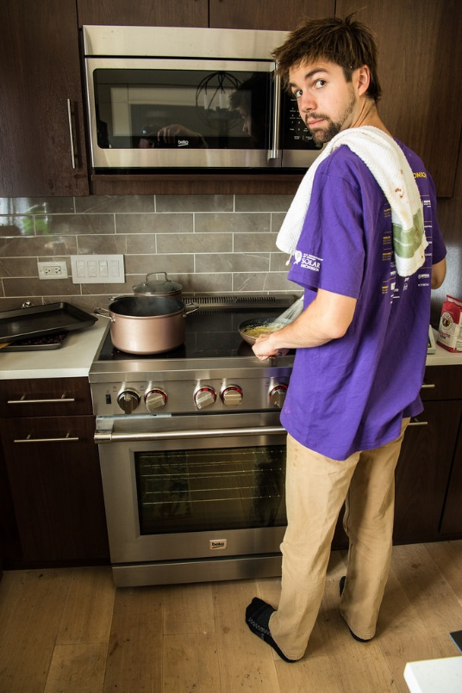
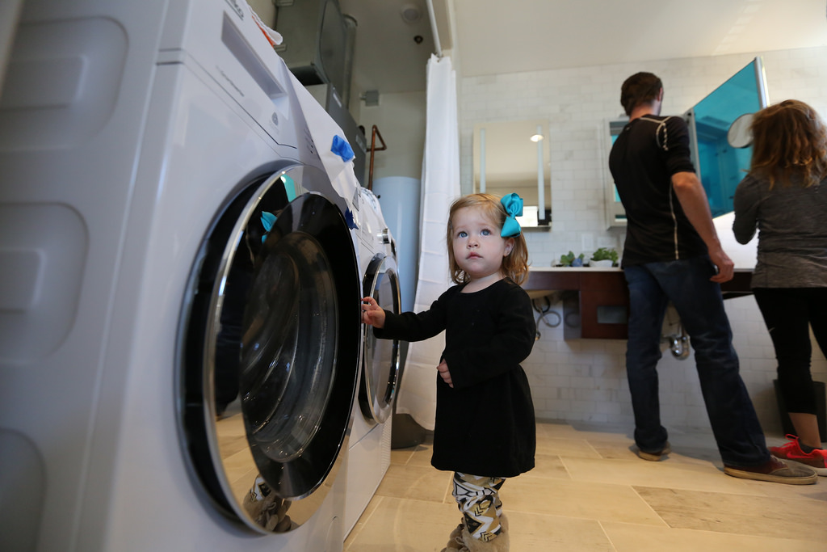
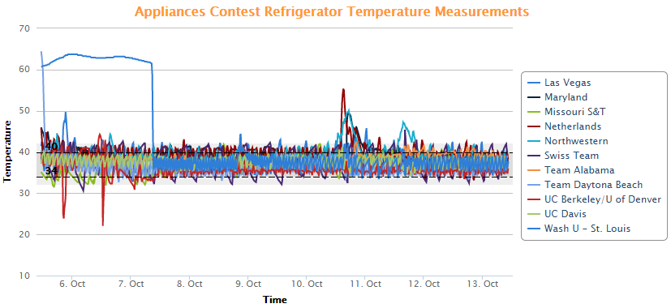
What is the Solar Decathlon?
APPLIANCES
This contest is designed to mimic the appliance use of an average U.S. home. Teams earn points for operating their refrigerator and freezer, washing and drying laundry, simulating cooking tasks and hot showers.
Full points are awarded for:
Maintaining the refrigerator temperature between 34°F (1.1°C) and 40°F (4.4°C)
Keeping the freezer temperature between -20°F (-28.9°C) and 5°F (-1.5°C)
Washing several loads of laundry
Drying several loads of laundry using active or passive drying methods
Simulating cooking by using a kitchen appliance to vaporize 5 pounds (80 oz or 2.3 kg) several times during the competition
Simulating several showers by drawing 15 gallons (56.8 L) of water in 10 minutes or less at an average temperature of at least 110°F (43.3°C).
Click on a button to know more about each contest
= focuses on learning objectives
CLICK TO CONTINUE
Notes:
Photo credits: Dennis Schroeder/U.S. Department of Energy Solar Decathlon; John De La Rosa/U.S. Department of Energy Solar Decathlon

Slide 12
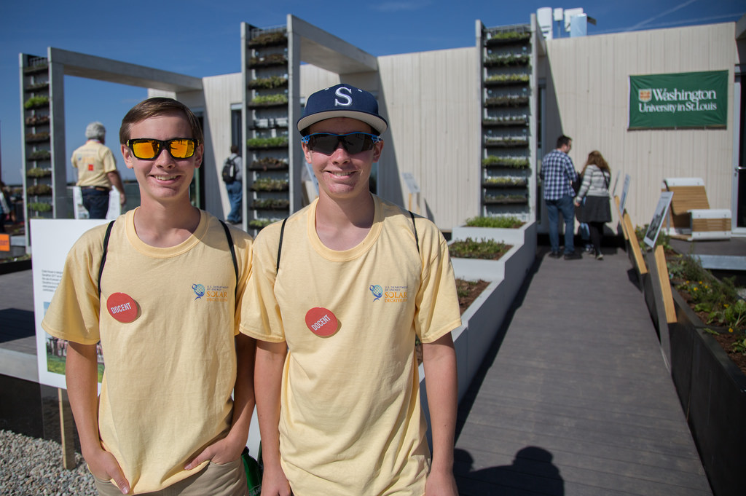
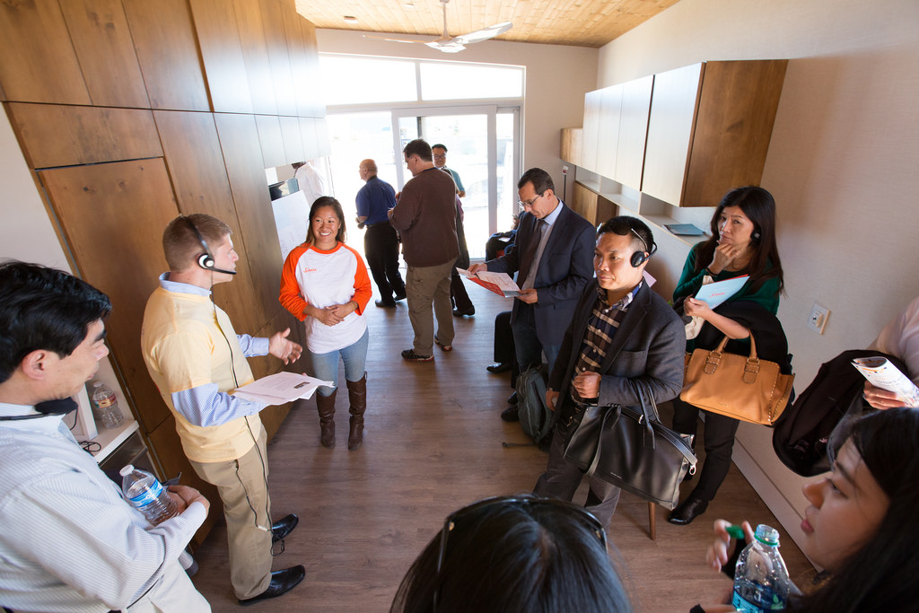
What is the Solar Decathlon?
COMMUNICATIONS
Teams must develop and implement communications strategies to engage their local communities, provide free tours to visitors during the event in Denver, and make an impact across the world through their digital presence and media outreach.
A jury of communications professionals evaluated each team's communication strategies, materials, and efforts to educate, inform, and interest the public criteria regarding:.
Strategy
Implementation
On-Site Communications
Click on a button to know more about each contest
= focuses on learning objectives
CLICK TO CONTINUE
Notes:
Photo Credits: John De La Rosa/U.S. Department of Energy Solar Decathlon

Slide 13
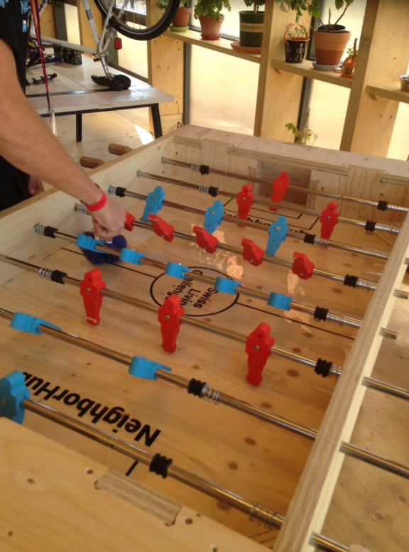
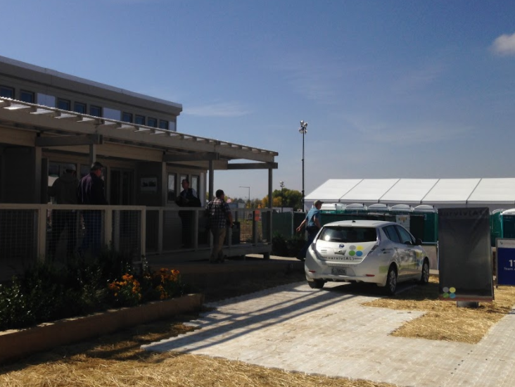
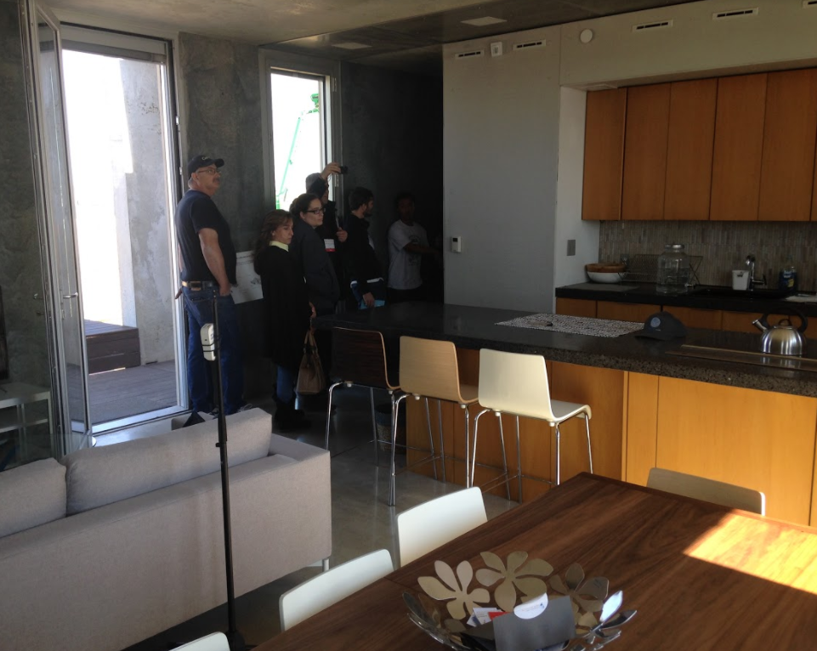
What is the Solar Decathlon?
HOME LIFE
Teams are required to engage in a variety of activities just like real homeowners. They share meals with friends and neighbors, watch television, use their computers, and host games nights. They even commute in an electric vehicle charged from the house's solar electric system.
Points were awarded for:
Maintaining comfortable light levels throughout the house for several hours each day of the competition
Operating a television and computer several hours each day
Hosting two dinner parties for neighbors
Hosting a game night for neighbors
Driving an electric vehicle at least 25 miles (40.2 km) within 75 minutes.
Click on a button to know more about each contest
= focuses on learning objectives
CLICK TO CONTINUE
Notes:
Photo credits: Steve Rackley

Slide 14
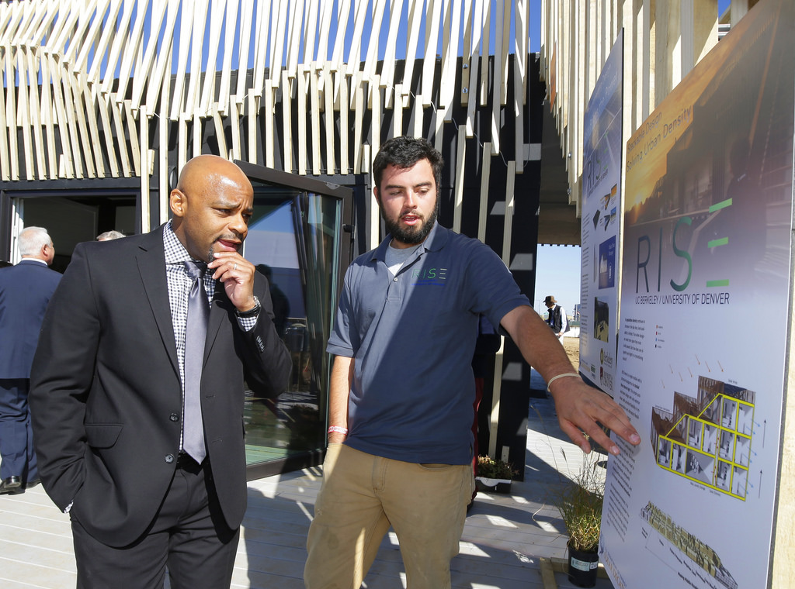

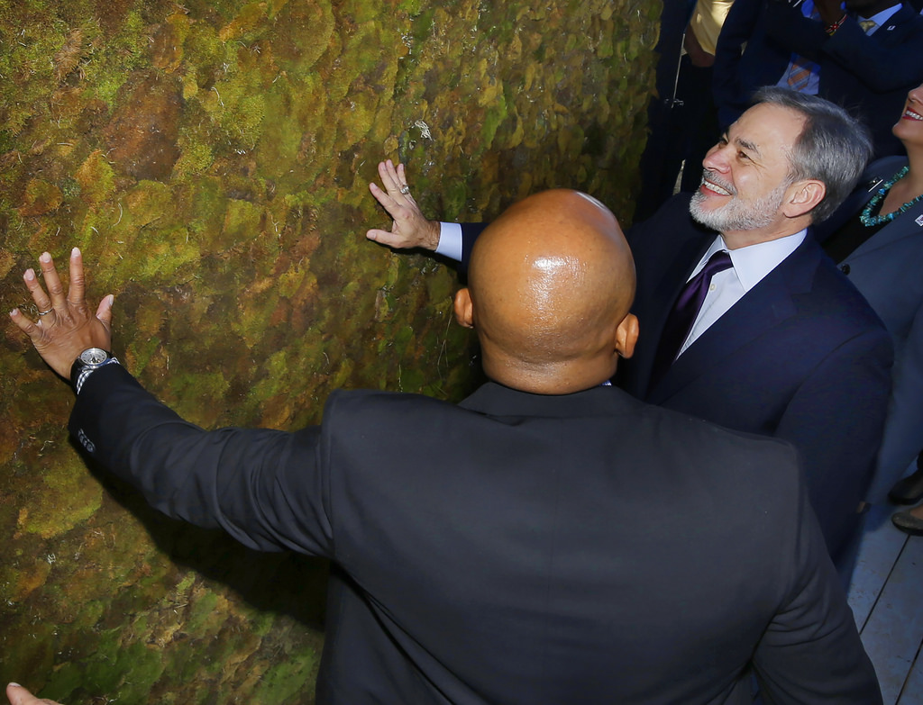
What is the Solar Decathlon?
the Innovation Contest encourages teams to take a thoughtful approach to innovation, rather than being limited solely to off-the-shelf solutions.
A jury of industry professionals evaluated each team's approach to innovation, from design to execution, using criteria regarding:
Research
Sustainability
Innovation
Durability and Safety
Click on a button to know more about each contest
= focuses on learning objectives
CLICK TO CONTINUE
Notes:
Photo Credits: Jack Dempsey/U.S. Department of Energy Solar Decathlon; John De La Rosa/U.S. Department of Energy Solar Decathlon

Slide 15
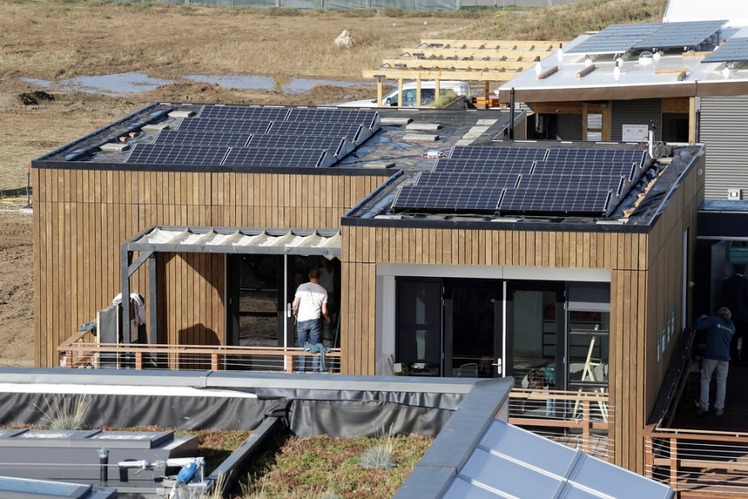
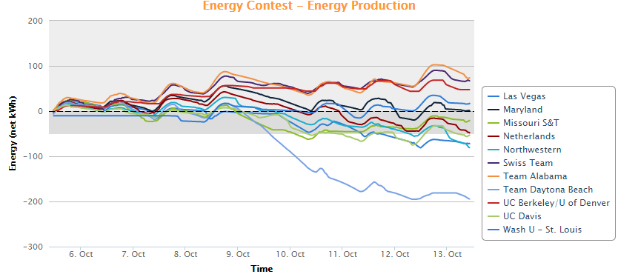
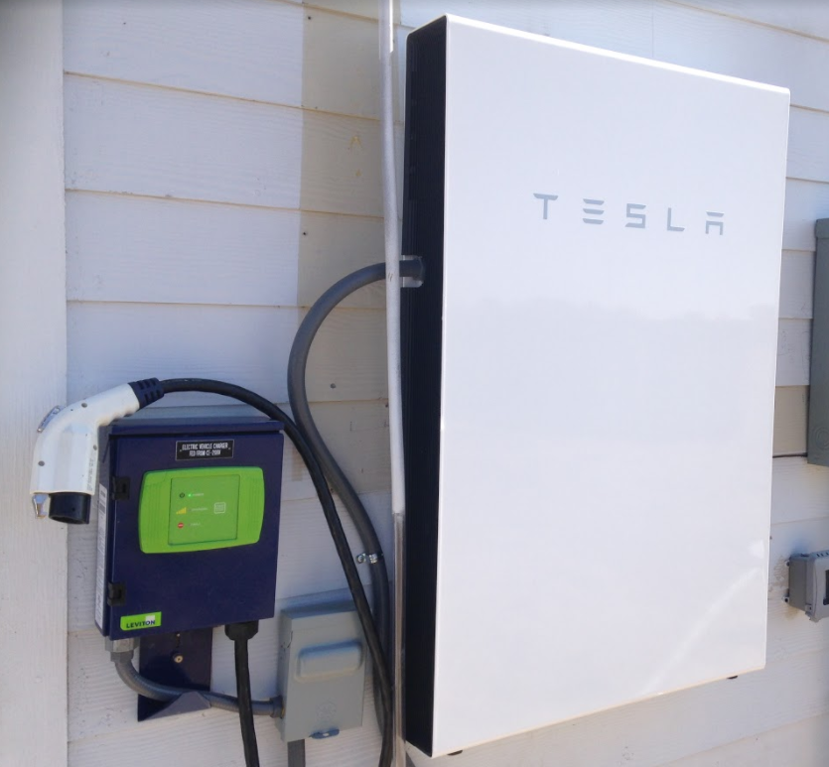
What is the Solar Decathlon?
Each team's energy use was monitored, both what they contributed and drew from the Solar Decathlon electricity grid.
For energy production, teams received full points for producing at least as much energy as its house needs, thus achieving a net energy consumption of zero during the competition.
Each team will began the competition with a $5.00 charge on their "account" to represent the fixed costs of utility connection. Over the course of the competition, each team accrued additional charges at different rates, depending on the time of day, for net consumption of electricity from the Solar Decathlon grid. Each team was also "credited" different amounts, depending on the time of day, for net production of electricity they provide back to the Solar Decathlon grid. Teams earned full points if they finish the competition with a credit of $10.00 or more.
Click on a button to know more about each contest
= focuses on learning objectives
CLICK TO CONTINUE
Notes:
Photo credits: Steve Rackley; Jack Dempsey/U.S. Department of Energy Solar Decathlon

Slide 16
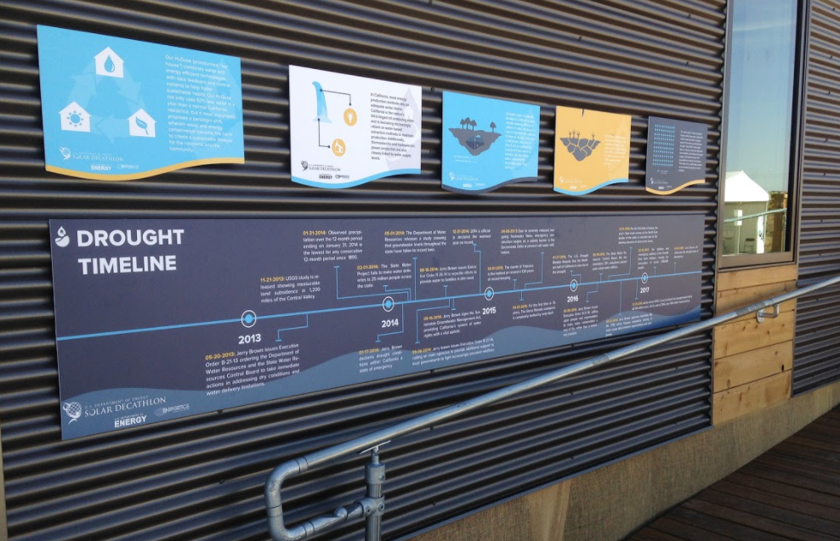
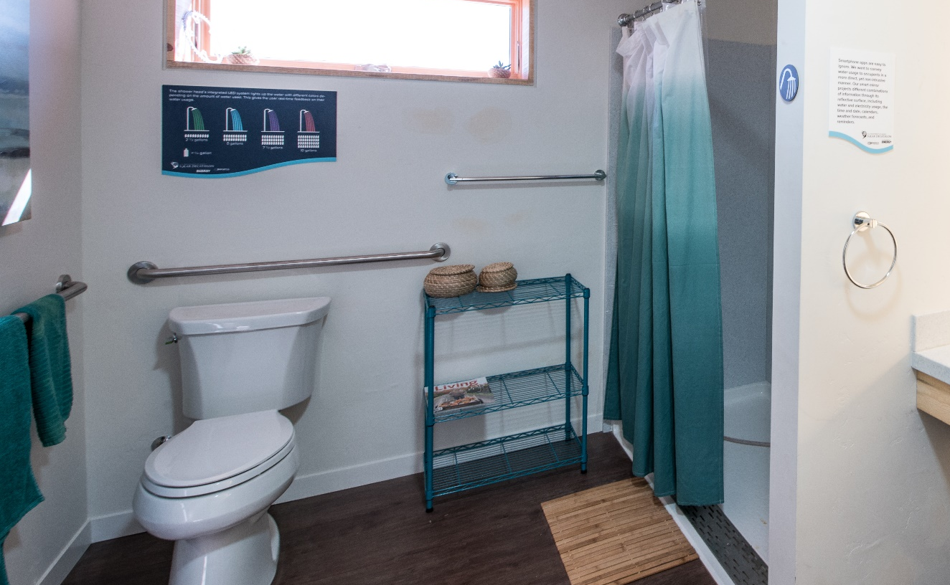

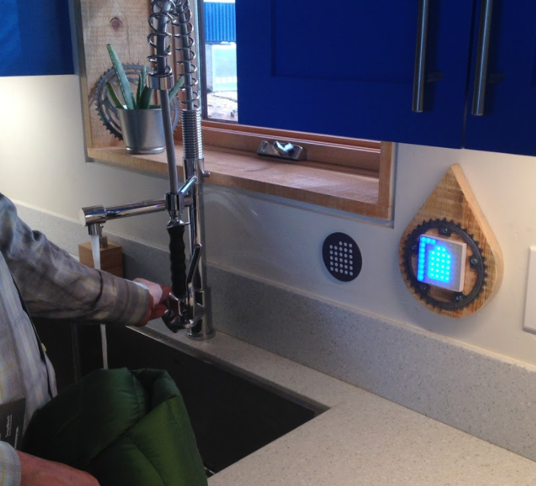
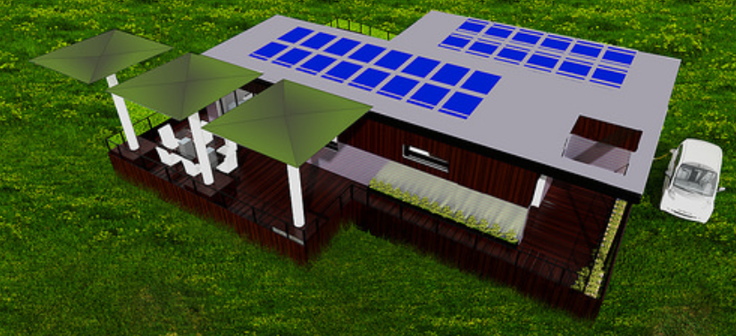
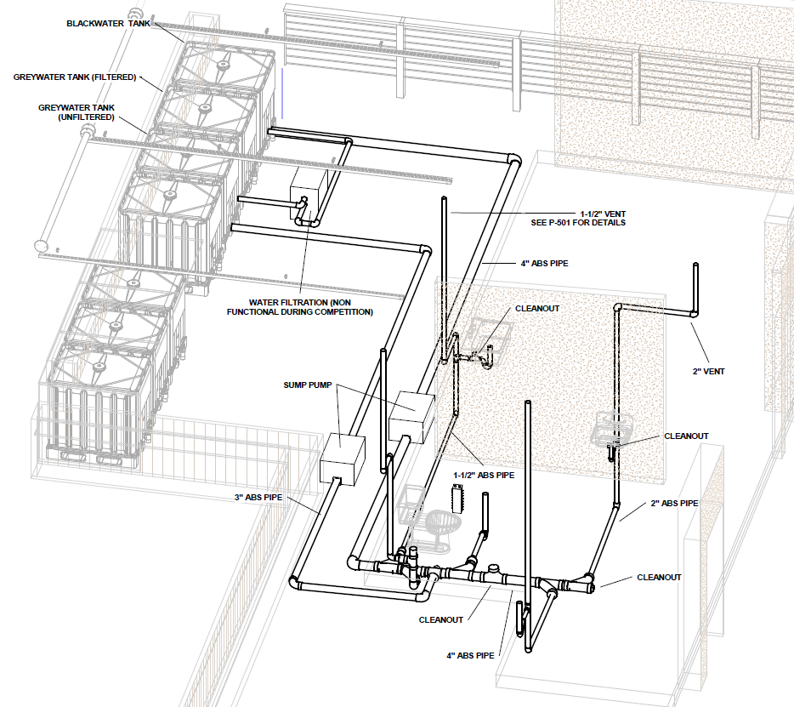
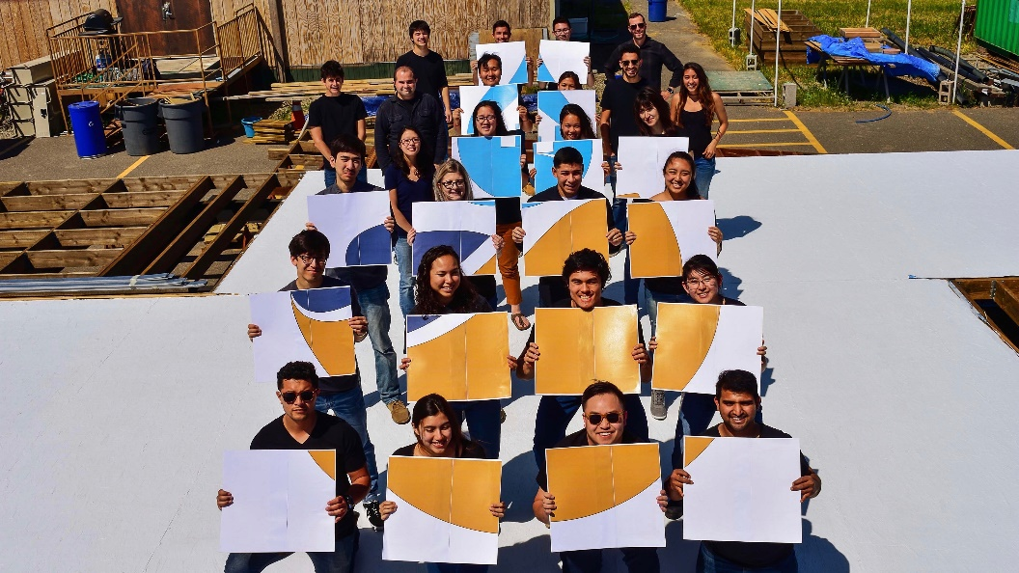

The best houses from SD2017 for water:
The team’s primary focus is water conservation, and the house is designed to use 50% less potable water than a typical residence.
The house features greywater reuse systems, including a cutting-edge sanitization technology developed at the university.
Sophisticated monitoring and feedback systems educate and inspire residents to be the champions of their own water reduction.
Runners-up
Notes:
Credits: UC Davis, Steve Rackley, Dennis Schroeder/U.S. Department of Energy Solar Decathlon.
Designed on the basis of increasing probability and severity of drought conditions in California.
Bottom right picture – LED indicators light up when water is turned on. The greater the flow, the more lights light up in the middle. The lights around the edge of the display increase as more water is used. There is one of these next to each appliance that uses water.

Slide 17
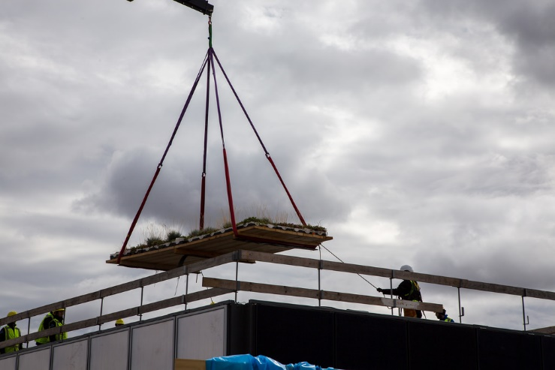

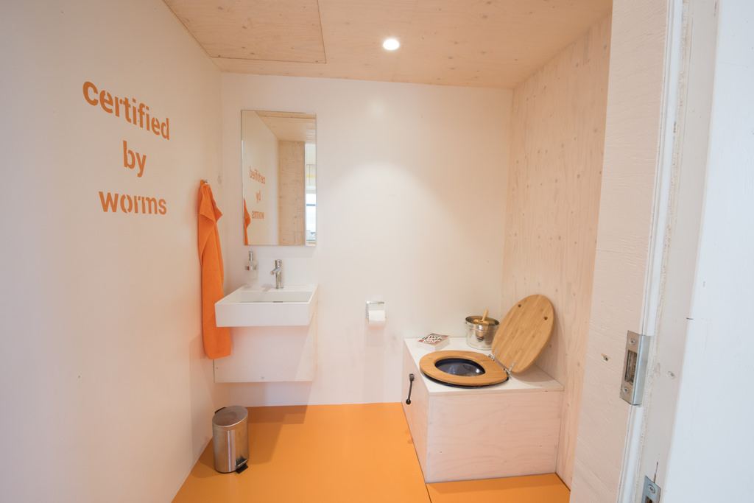
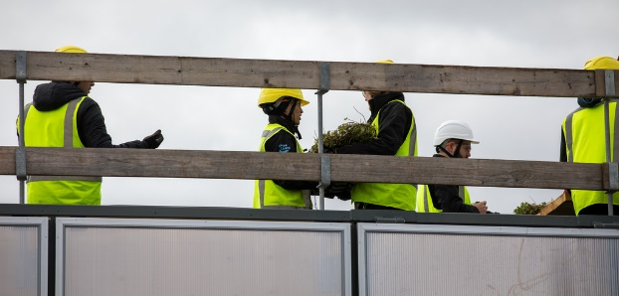




The best houses from SD2017 for water:
Scott Morrissey, director of sustainability at Denver International Airport said, “The clearly calculated amount of actual water consumption is very low for this house. With a green roof, this house expertly integrates storm water into its design. This house successfully uses kitchen water as part of a grey water system, sports an innovative composting toilet, and offers simplicity with a combined water and energy dashboard to help track usage.”
Winners
Notes:
Credits: Swiss Team; Dennis Schroeder, Cody Williams/U.S. Department of Energy Solar Decathlon, Denver International Airport
Green roof helps to absorb, collect and filter rainwater which is then used for ‘aquaponics’ (see https://www.theaquaponicsource.com/what-is-aquaponics/).
Dry compositing toilet means no water is used. Waste entering the toilets is over 90% water, which is evaporated and carried back to the atmosphere through the vent system. The small amount of remaining solid material is converted to useful fertilizing soil by natural decomposition. The remaining human solid waste if properly composted is safe to use as a fertiliser.

Slide 18







The best houses from SD2017 for energy:
The design allows cross-ventilation and shaded porches and canopies to cool the home without air conditioning.
A robotic cooler can be summoned with a remote to provide localized cooling, so that central heating and air conditioning can be more energy efficient. Energy and climate can be controlled digitally.
A large northern porch, covered with a transparent canopy allows light penetrate the interior of the house in the early morning and late evening. An open ceiling combined with high-level windows increases daylighting.
Construction includes thick, double-stud, well-insulated walls.
The high-albedo roof does not absorb as much heat from the so decreases the need for cooling.
3rd place
Notes:
Credits: Team Alabama, Steve Rackley, Dennis Schroeder/U.S. Department of Energy Solar Decathlon

Slide 19









The best houses from SD2017 for energy:
Large glass windows and doors on the south side.
The north façade is a green wall of moss that works to sequester carbon and clean the air.
A solar chimney naturally ventilates the house by using convection of air heated by passive solar energy
The house features wool insulation.
Recovers and reuses heat that is typically wasted in most houses e.g. to heat water
A digital energy management system
Stores energy produced by solar PV in a Tesla Powerwall battery for night-time use
Runners-up
Notes:
Credits: Steve Rackley, UC Berkeley/UC Denver, Jack Dempsey, Dennis Schroeder, John De La Rosa/U.S. Department of Energy Solar Decathlon
The energy contest was won by Swiss Team, who was the only team to finish above the magic ‘$10’ net energy by the end of the competition.

Slide 20





Some of my personal favourite features…
The SMUD Tiny House (not part of the competition): My post empty nester pipe-dream!
Northwestern: Modular interior walls and sliding porch.
Swiss Team: Entry was more based on a community centre with movable walls to make living spaces. I liked the wooden foosball table best!
Team Alabama: A safe room with tornado panels is made to FEMA standards to withstand 250-mph winds. Even if a storm destroys the house, this room will remain intact and keep occupants safe.
Missouri S&T: A series of Enphase smart batteries and inverters which connect wirelessly for real time data on energy production, storage and usage (I have the smart inverters on my solar panels at home – great for data geeks!)
... not forgetting… >
Notes:
Credits: Steve Rackley

Slide 21

…SD2017’s dancing toilets!
Notes:
Credit: Steve Rackley

Slide 22

Tasks
Water:
Explain how the following features from the Swiss Team & UC Davis houses help to conserve water:
- Green roof
- Dry composting toilet
- Real-time monitoring of water usage
Energy:
Explain how the following features from the Team Alabama & UC Berkeley/UC Denver houses help to conserve energy:
- Large south-facing windows
- Sheep’s wool insulation
- Solar PV system with battery storage
The earlier slides and p242-245 in the Hodder Textbook may help you

Slide 23




What can you do?
http://www.energysavingtrust.org.uk/home-energy-efficiency/energy-saving-quick-wins
http://www.anglianwater.co.uk/environment/how-you-can-help/

