Slide 1
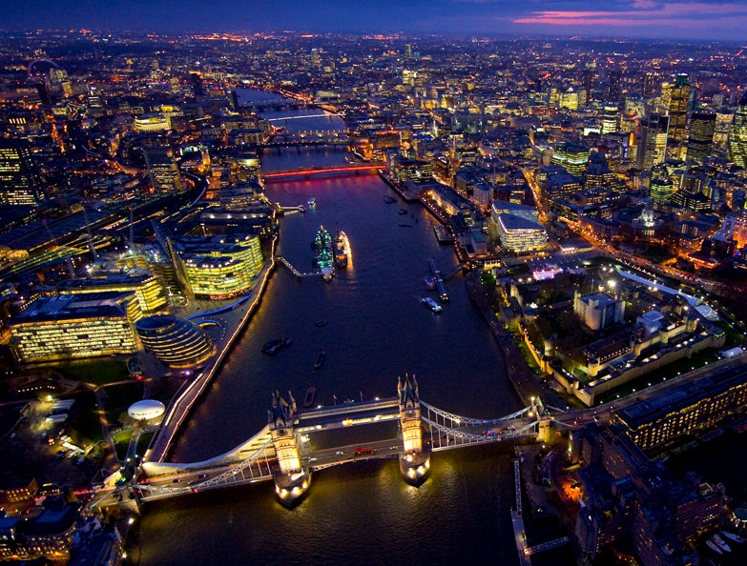
Visit to London!
K.Rackley (FEHS 2012)

Slide 2
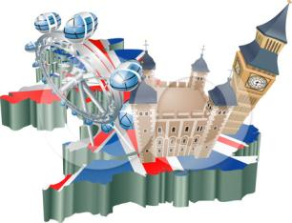
Instructions
Sorry you couldn’t come with us on the trip! However, I hope that this virtual tour will give you a sense of what we got up to! This work will be useful in your end of Unit assessment!
Simply follow the slide-show through to the end, following the instructions carefully as you go along! The questions that you must answer in full sentences have numbers like this: (2).
You will need:
Your exercise book
Pen and pencil
Colouring pencils/pens
A map of St Katharine’s Dock (teacher will provide)

Slide 3
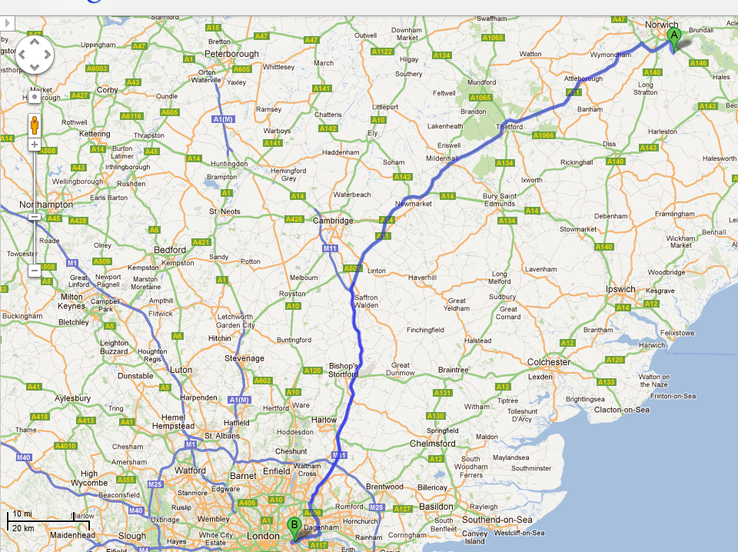
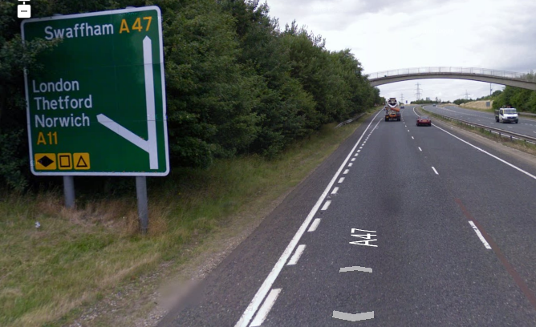
OFF WE GO!
We are still around 100 miles out but London is already sign posted where the A47 and A11 meet! Have a think why so!
London has a large sphere of influence.

Slide 4
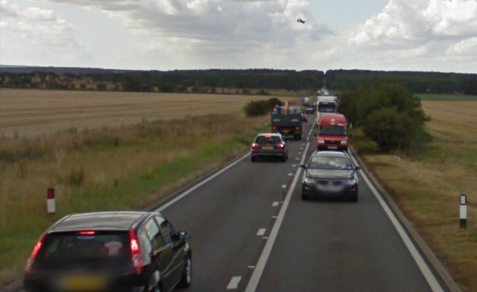
TRAFFIC JAM!
Oh no this has slowed us down a bit. The A11 is only single carriageway through here.
(1) IN YOUR BOOK: Explain why traffic congestion causes pollution and loss of income through wasted time (think about commuters or transport companies)
However the government are dualling (two lanes) the A11 starting in 2013.
(2) IN YOUR BOOK: Use this news article to help you describe 2 possible benefits to the dualling of the A11.

Slide 5
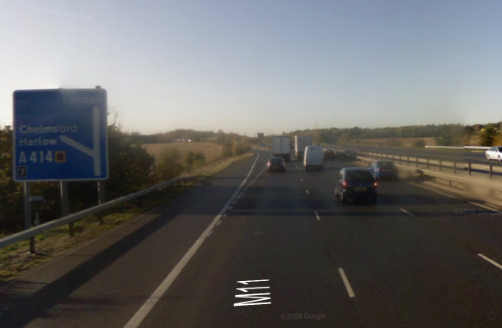
PASSING A NEW TOWN
Almost there now. We pass Harlow, a New Town built in the 1950s. Some Londoners were moved here after WW2 in an attempt to stop London’s urban sprawl.
The M11 provides a very quick commuter route from here into London, but that makes it busy!
We are only about 25 miles out now. The landscape is really set to change!

Slide 6
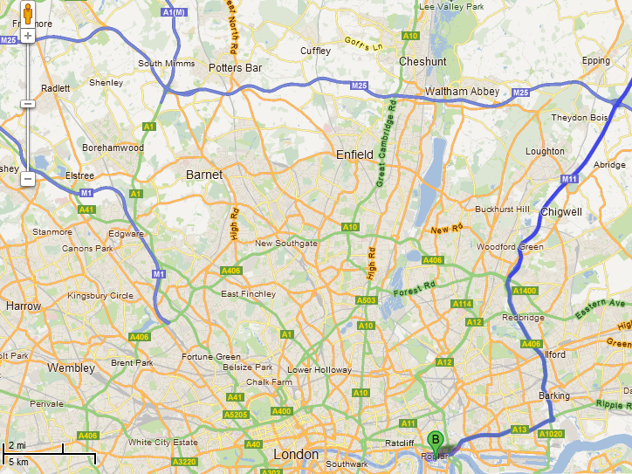
URBAN TRANSECT
The road we are on gives us a fantastic view of how rural becomes urban. A line along this is called an ‘urban transect’.
(3) Copy the table below into your books. As you finish your journey, fill in the table using pictures and the information on the following slides.
I
Land Use Zone | Example of location in London | Land use & characteristics
Outer Suburbs
Inner Suburbs
Inner City
Central Business District

Slide 7
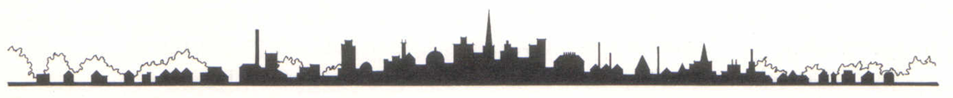
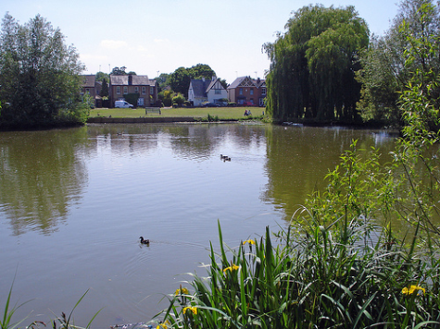
URBAN TRANSECT – London’s OUTER SUBURBS
Theydon Bois
Most houses here are spacious and often have gardens. People own cars and many use them to commute into London.
This village has an Underground Station which takes you all the way into Central London too.
We are in London’s green belt.

Slide 8
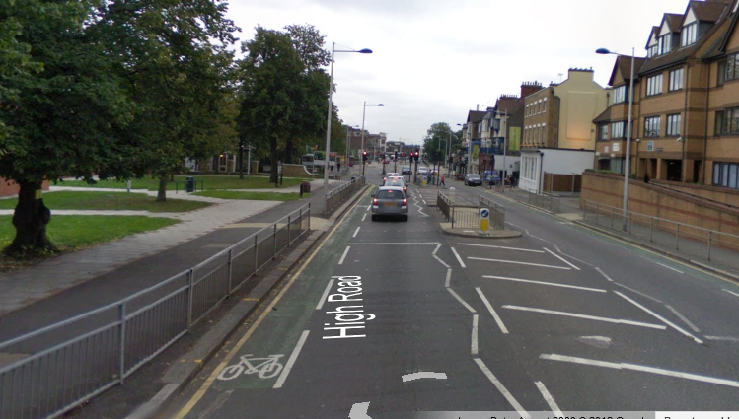
URBAN TRANSECT – London’s INNER SUBURBS
Woodford
There are still some green spaces here, but the buildings are getting taller. There are more flats as well as houses.
Some areas will have their own shopping streets.
Roads are fairly wide and busy.

Slide 9
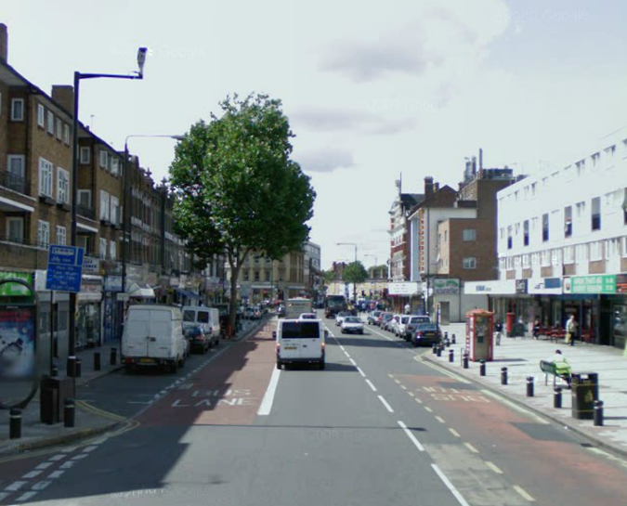
URBAN TRANSECT – London’s INNER CITY
Newham
Blocks of flats and terraced housing dominate here. There is evidence of old industries and businesses that have shut down.
A large proportion of people are relatively poor and many are from ethnic minorities. Crime rates can be quite high due to high unemployment rates.

Slide 10
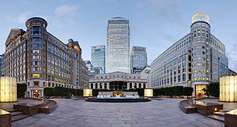
URBAN TRANSECT – London’s CBD
Canary Wharf
This is not London’s primary Central Business District (CBD) but It is considered it’s second! Large expensive skyscrapers for professional office and financial workers. Top-of-the-range apartments and shops; you would need a lot of money to live and shop here!
Many different types of transport links lead here too. The tube, light railway, roads, buses etc…

Slide 11
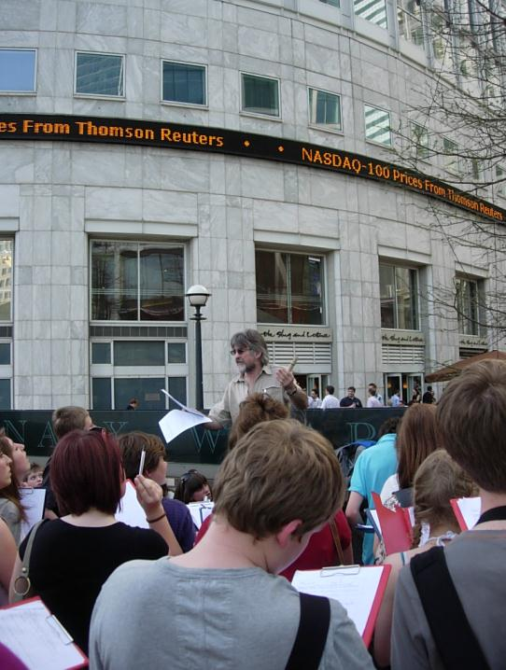
Canary Wharf!
A ‘ticker tape’ showing the performance of the Stock Exchanges!
Our first stop! Use the pictures and information on this slide and the following slides to answer these questions in full sentences. You can come back to this slide to remind yourself of them!
(4) What kind of materials are the buildings made of? What does this tell you about the expense?
(5) Who has Canary Wharf been built for? How have they ‘won’ from this development.
(6) Who used to use this area? Why would they be considered ‘losers’ of this development?
(7) Name as many different transport links as you can find!
Marble and polished granite building materials

Slide 12
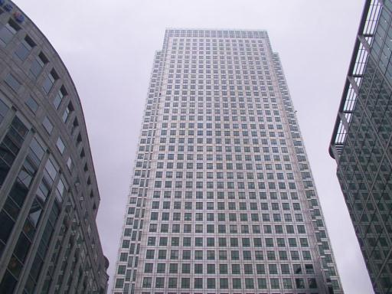
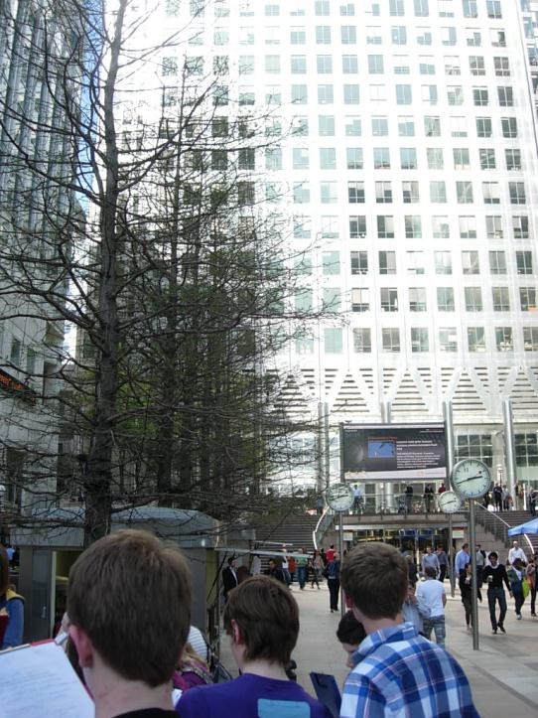
“One Canada Square” was the tallest building in the UK, but was overtaken in 2012 by another London CBD building. It is 770ft & 50 stories high! So high it has to have a flashing light on top to warn aircraft that it is there!
Made of reinforced steel and laminated glass which are both flexible in the wind. This means it is more resistant to the weather.
Examples of businesses who rented space in “One Canada Square” have been:
Banks e.g. Bank of New York Mellon, Clydesdale, HSBC, NatWest
Investment e.g. Moody’s
Insurance e.g. Euler Hermes, MetLife
Global trade e.g. International Sugar Organization, Samsung Electronics
Newspapers e.g. Trinity Mirror
These are mostly MNCs who pay highly qualified people huge wages

Slide 13
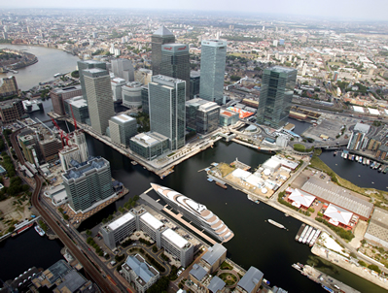
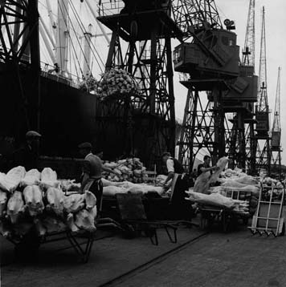
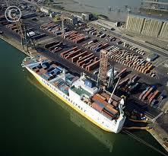
You can see how expensive this development is! Definitely need money to do business here…
Before the modern development, working-class people with few skills got paid low wages to unload ships that came into the docks. They were called “dockers”.
Unfortunately container ships (like this one down the river at Tilbury) were too big for these docks, so dockers lost their jobs and the docks (for shipping) closed down. This is why the expensive office blocks were built.

Slide 14
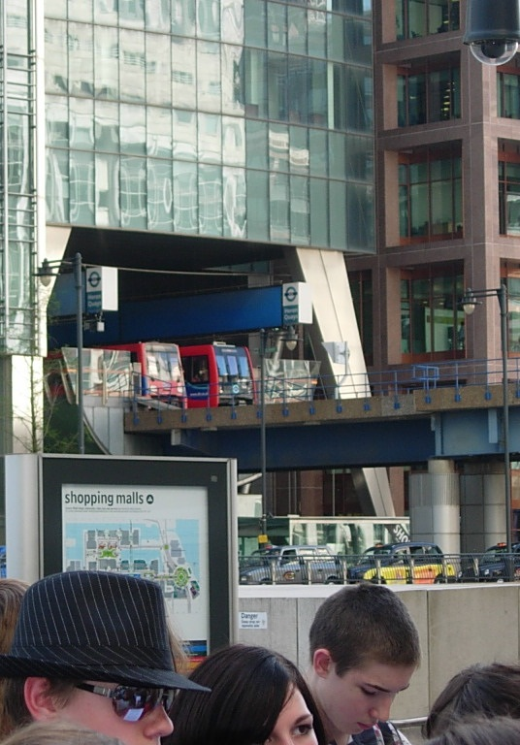
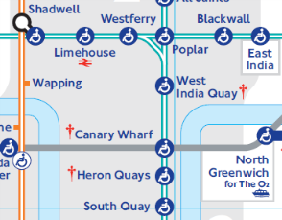
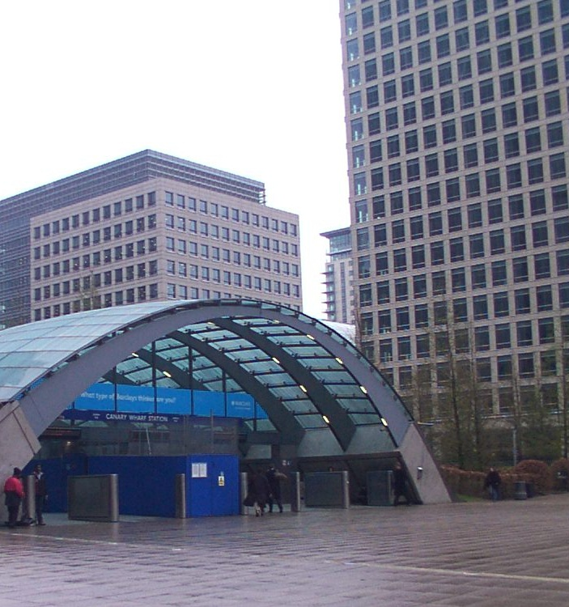
London’s transport network is an example of “integrated transport”, where many forms of transport link into each other
The Docklands Light Railway (DLR) tram line links in with the Underground.

Slide 15
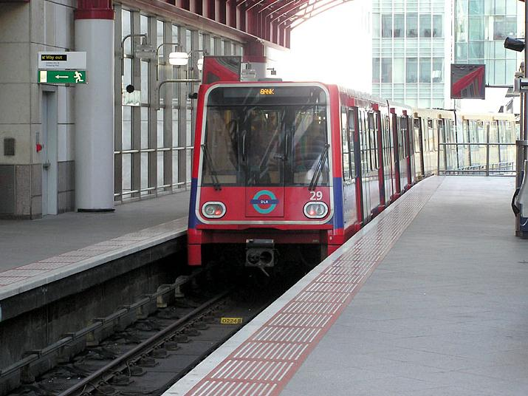
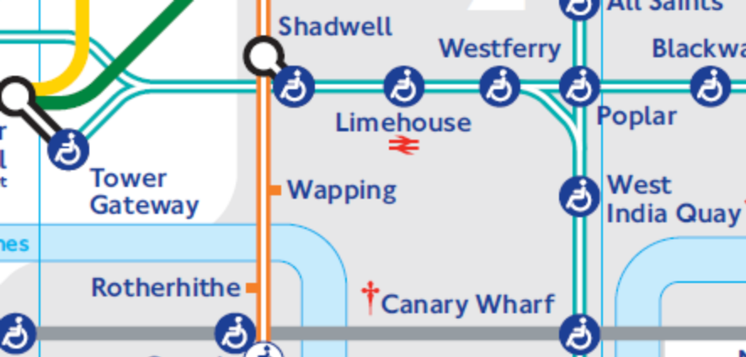
It’s time to jump on the Docklands Light Railway to get to our next stop! Mind the gap please!

Slide 16
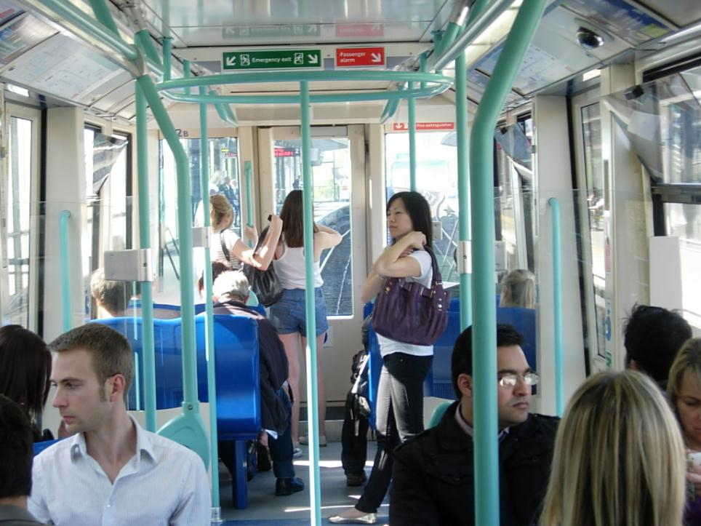

Slide 17
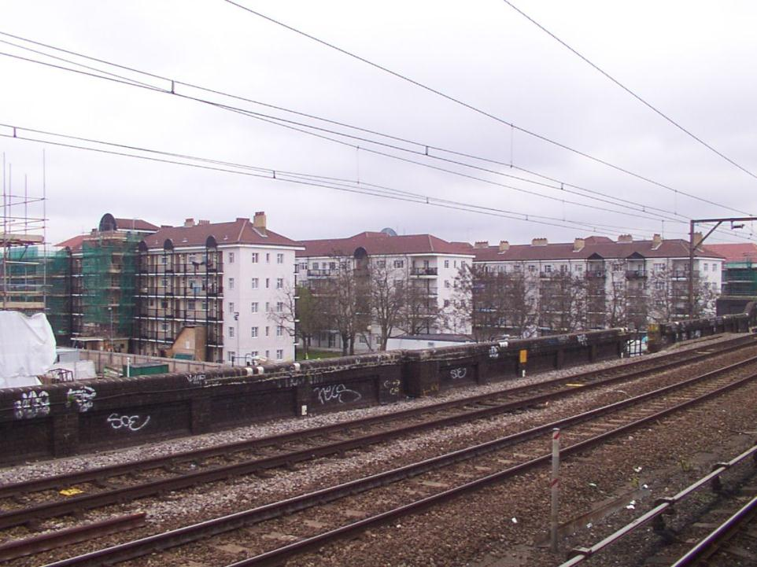
Changing trains at Shadwell. We are not far away from Canary Wharf and it is so different here! Definitely an ‘inner city’ area. Spot any signs of deprivation?

Slide 18
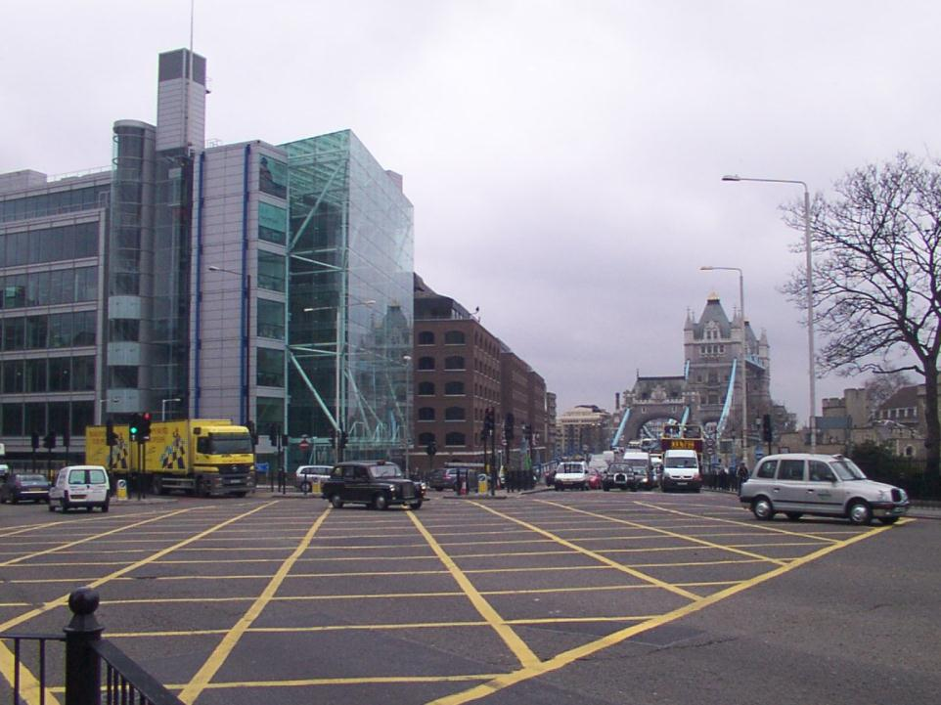
This is our stop. A more typical London scene. Lots of traffic and plenty of history! We can see Tower Bridge and the Tower of London too! It’s a quick walk to our next destination…

Slide 19
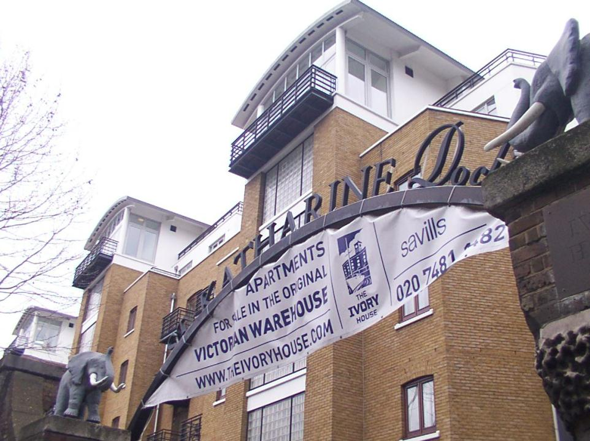
St Katherine’s Dock
Welcome to St Katharine’s Dock!
Hmm.. I wonder what they used to trade and off-load when the dockers worked here! Any clues?

Slide 20
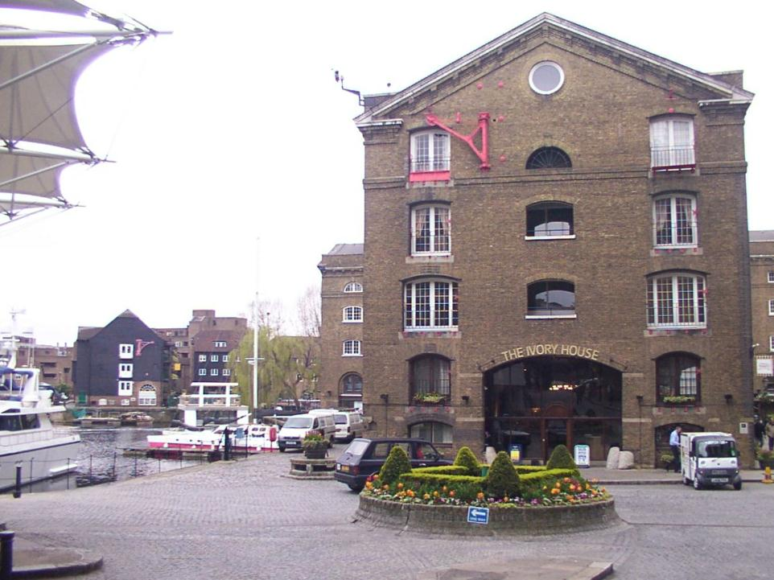

Slide 21
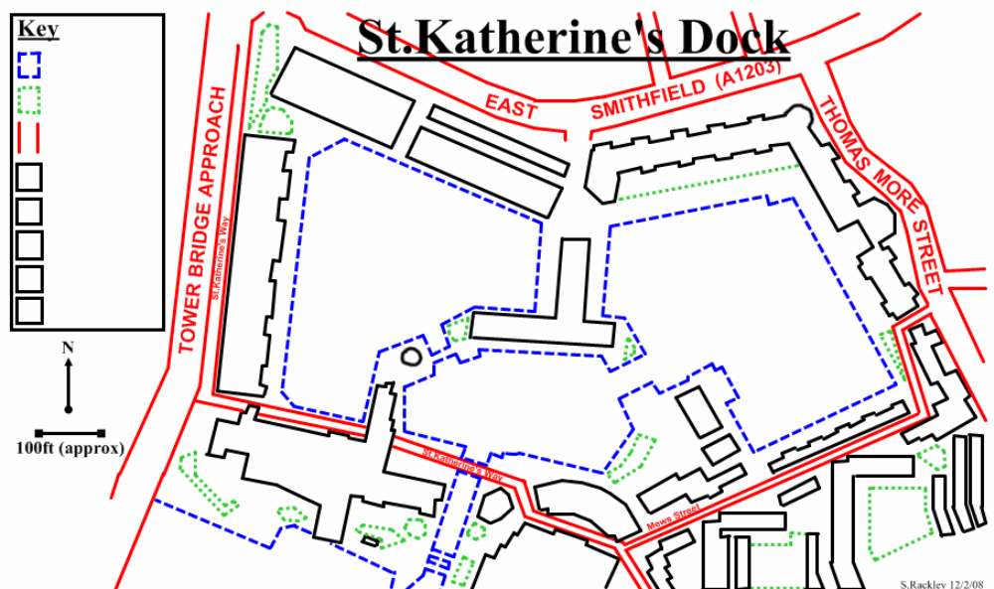
The teacher has given you a map! Time for some mapping work!
(8) “Walk around” the Docks by clicking on parts of the map. Using the key, correctly colour the map to show the land-use of the area. Some blocks may be a combination of more than one colour!
Areas of water
Greenery
Roads
Residential
Shopping/retail
Leisure/tourism
Offices
CLICK HERE WHEN YOU ARE DONE!

Slide 22
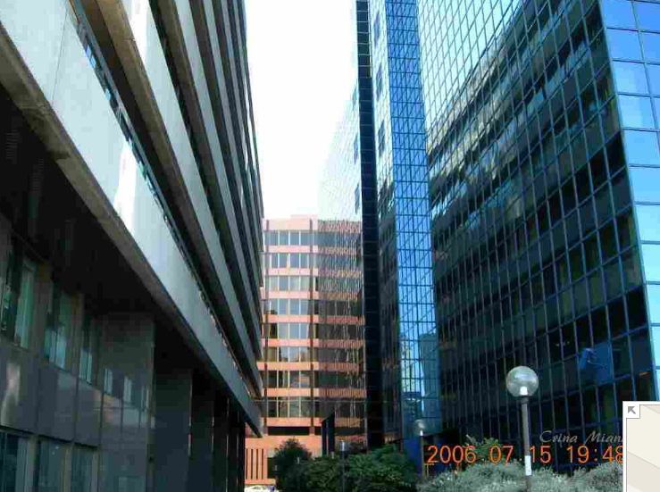
COMMODITY QUAY & TOWER BRIDGE HOUSE
These buildings are mostly rented out for office space, but Commodity Quay does have a few residential apartment spaces too.
Businesses such as solicitors and legal advice services have taken up rent in these.
Both buildings are relatively modern and were built after the docks closed down.
BACK TO MAP

Slide 23
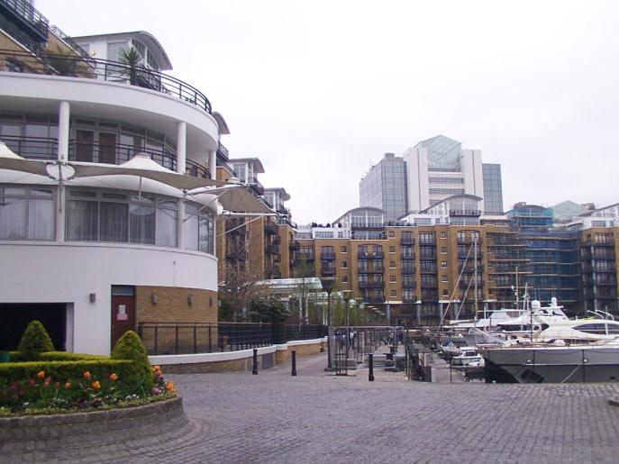
STAR PLACE & “THE COURTS”
You need to be very rich to afford to live here! It is not uncommon for celebrities or rich global business owners to own or rent one of these apartments. Some of these will also own the yachts in the dock.
These are top quality living spaces (residential). A two bedroom apartment can be rented for around £4,000 a month! Don’t want to rent, and buy instead? You’d need at least £1 million!
BACK TO MAP

Slide 24
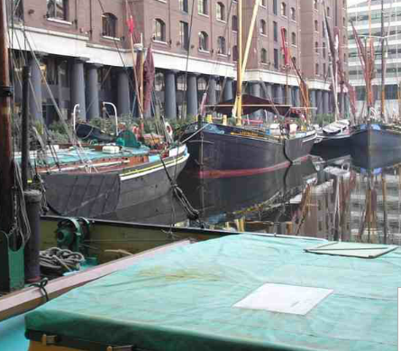
INTERNATIONAL HOUSE
A multi-use building. On the ground floor facing the docks the plots are used for expensive retail, art galleries and exhibitions. The plots above are used for both offices and apartments.
BACK TO MAP

Slide 25
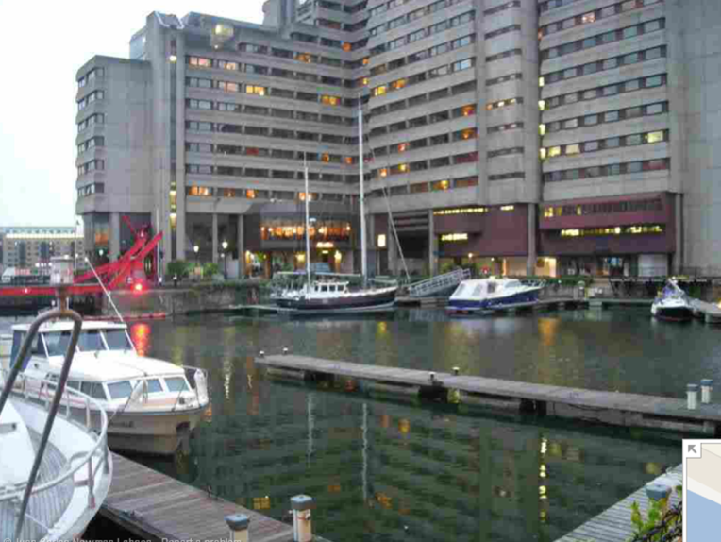
GUOMAN: THE TOWER HOTEL
It may not look like much on the outside, but this is one top quality hotel. The other side of the building has stunning views of the River Thames, Tower Bridge and the Tower of London.
The cheapest rooms are around £150 a night, while a suite will set you back at least £350 a night.
BACK TO MAP

Slide 26
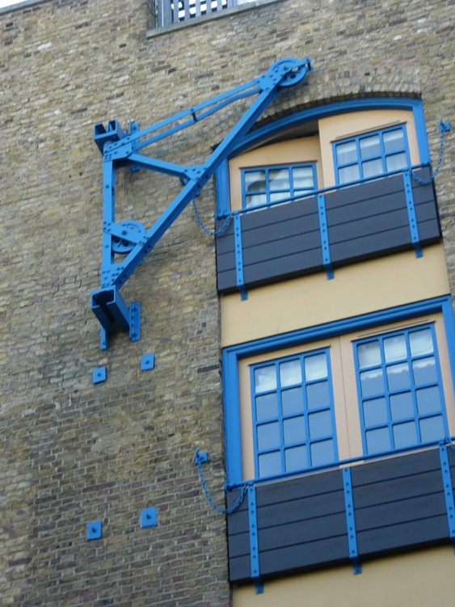
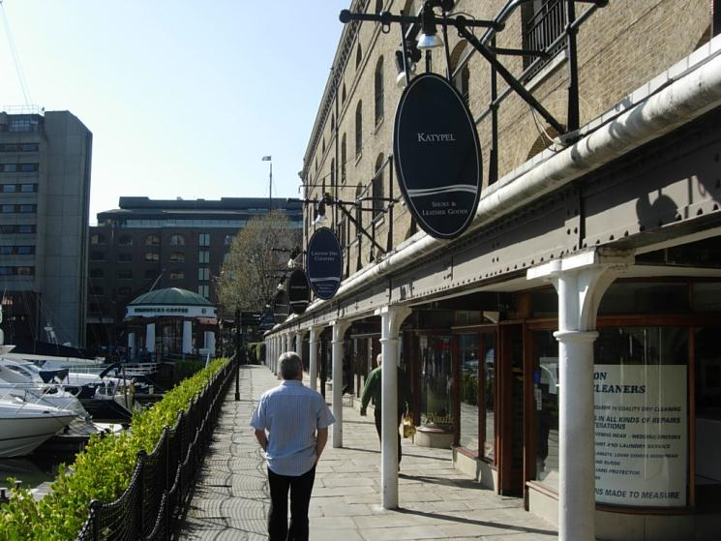
IVORY HOUSE
One of the original warehouse and unloading buildings that has been restored after the decline of the docks. You can see evidence all over the building with the balcony windows and pulleys. Ivory and other African produce was off-loaded here during the height of the British Empire.
Today the building is used for retail including cafes and gift shops. The main building is a bar, restaurant and nightclub for wealthy people!
BACK TO MAP

Slide 27
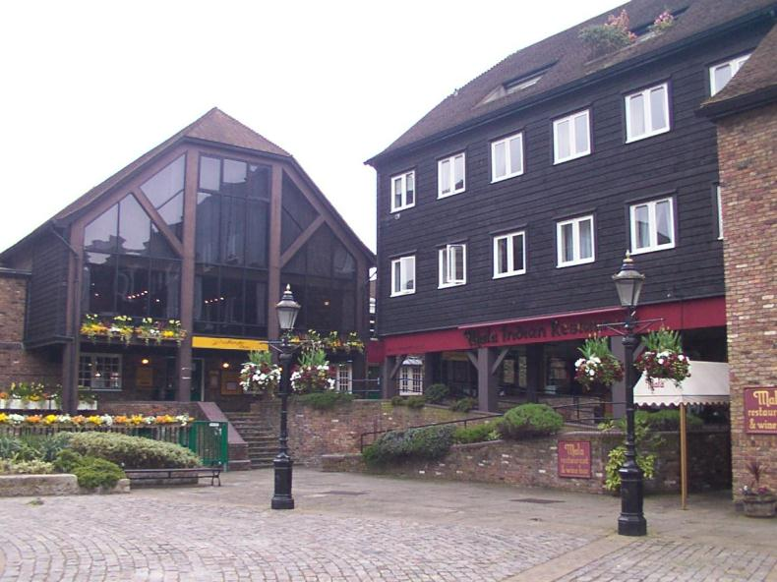
THE DICKENS INN & MALA INDIAN RESTAURANT
A little more affordable for the average person, the Dickens Inn is a bar and restaurant. It can be rented out for private functions. The Mala Indian Restaurant is also available for private hire.
Both these buildings were used during the day of the dockers, but have now been restored.
BACK TO MAP

Slide 28
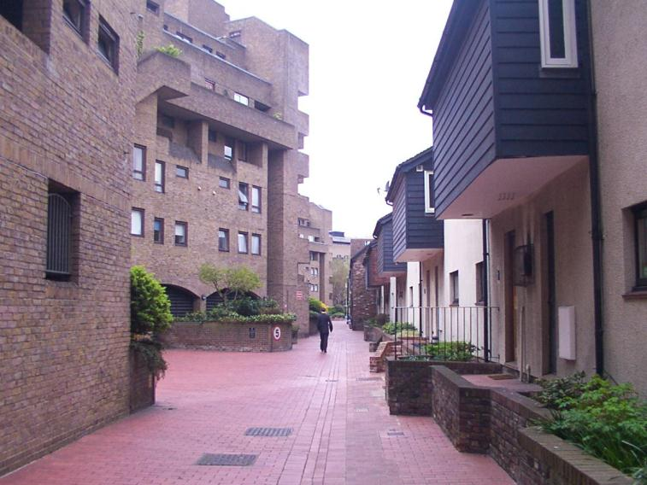
MEWS STREET
The houses on the right look more affordable! Actually, they will set you back at least £650,000! It is quite clear that this area is not for the average person. The building on the left rented for office space.
BACK TO MAP

Slide 29
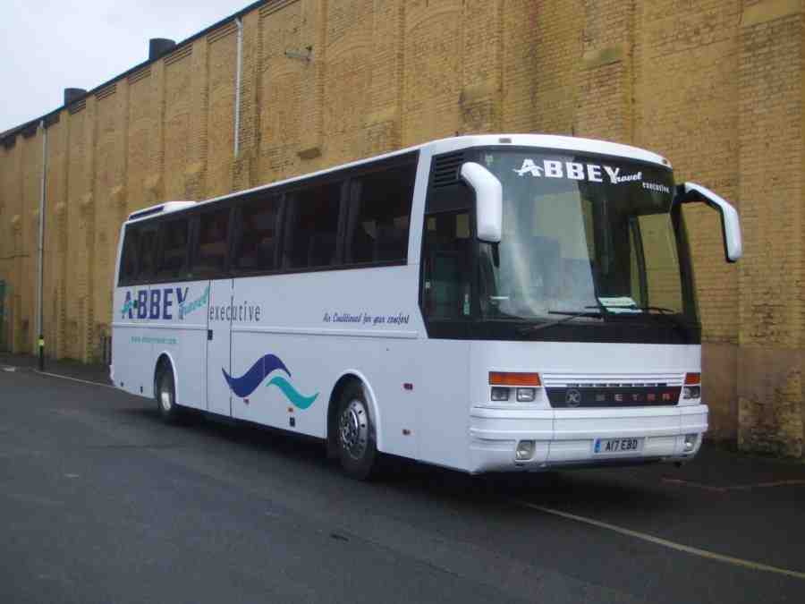
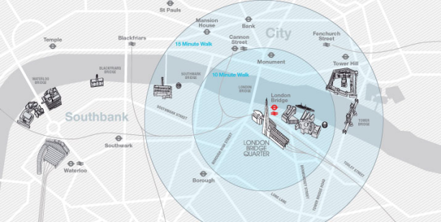
BACK ON THE COACH! TIME FOR OUR NEXT DESTINATION!
St Katharine’s Dock

Slide 30
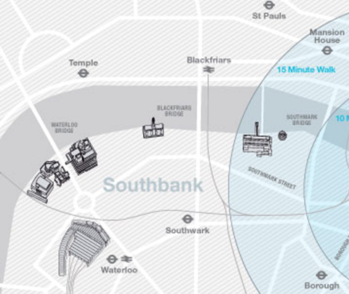
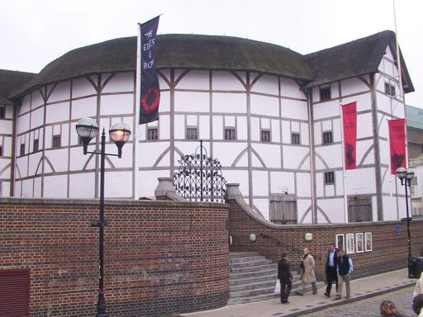
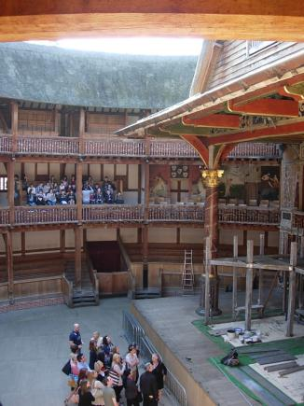
Thames Riverside Walk
As we walk along the Thames towards the London Eye, you may be asked by your teacher to do some tasks at some places. Let’s get going!
OXO Tower & Coin Street
Millennium Bridge
Waterloo Riverside
Tate Modern
Shakespeare’s Globe
London Eye
First stop is a tour of the Shakespeare’s Globe.
Have a look!

Slide 31
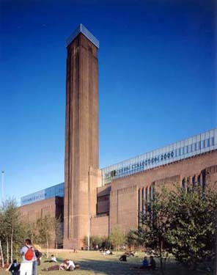
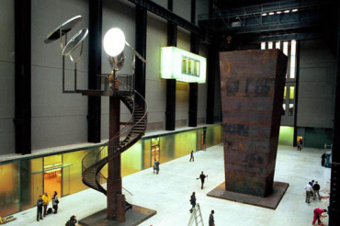
Thames Riverside Walk
OXO Tower & Coin Street
Millennium Bridge
Waterloo Riverside
Tate Modern
Shakespeare’s Globe
London Eye
The Tate Modern is a modern art exhibition centre and gallery that used to be a coal-fired power station!
The power station was built in two phases between 1947 and 1963. It consisted of a stunning turbine hall, 35 metres high and 152 metres long, with the boiler house alongside it and a single central chimney. The site had been mostly redundant since 1981 and conversion to a gallery started in 1995.

Slide 32
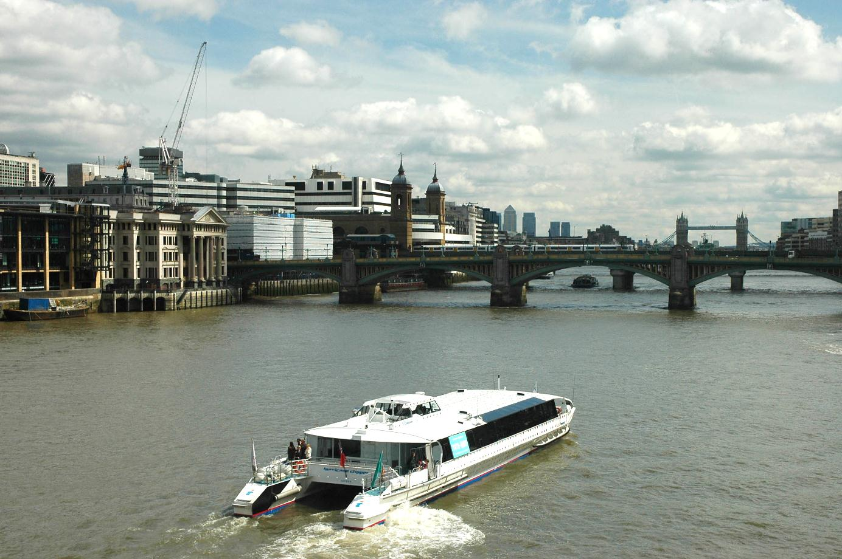
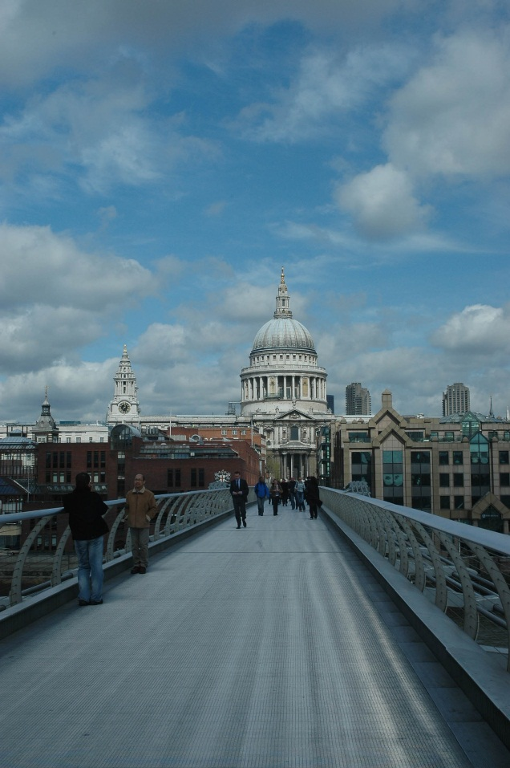
The cranes show you that London is constantly changed and growing with new buildings and older ones being regenerated.
Thames Riverside Walk
OXO Tower & Coin Street
Millennium Bridge
Waterloo Riverside
Tate Modern
Shakespeare’s Globe
Two CBD’s, Canary Wharf and “the City” containing…
London Eye
Different types of transport such as… because…
A mixture of historic and modern buildings…
Looking EAST
Boats on the river used for…
You are standing on the Millennium Bridge. The Tate is behind you and St Paul’s Cathedral is on the other side. It is a bridge for pedestrians only to encourage people to walk between the two sides of the river. Now… it wouldn’t be a field trip with out some sketching!
(9) Taking no more than 5 minutes, sketch the view you see from the Millennium Bridge (above) and annotate it by adding to the labels with what you have learnt so far. The label about the cranes has been done for you as an example!

Slide 33
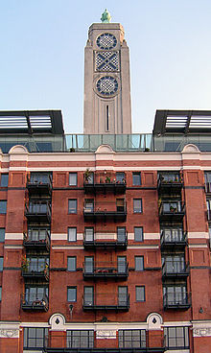
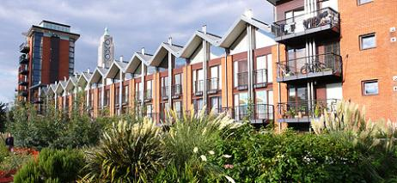
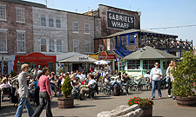
Thames Riverside Walk
The building was used as a meat cold store by the manufacturers of Oxo beef stock cubes in the 19th century. In the late 1970s and into the 1980s the building was going to be demolished the building and develop it and the adjacent Coin Street site into modern offices, but these were met with strong local opposition and two planning inquiries were held. After much legal fighting, the site was sold to a non-profit company set up by local people called the “Coin Street Community Builders “ (CSCB) for just £750,000.
OXO Tower & Coin Street
Waterloo Riverside
Tate Modern
Shakespeare’s Globe
London Eye
A mixture of historic and modern buildings…
(10) While the local people lost in the redevelopment of Canary Wharf, it seems they have won here.
Describe 3 differences between the Coin Street development and the Canary Wharf development.
Boats on the river used for…
Having won the legal fight, the local people and the CSCB set about developing the area for local people. They built affordable housing, a place for the market. But they also had to start paying back the loan they took out to buy the site, so some buildings and space have been rented out to high-end businesses, art galleries and wealthy people in order to make money.

Slide 34
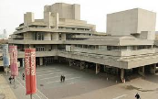




Thames Riverside Walk
While the residents won at Coin Street, after the warehouses and docks closed down the rest of the area in Waterloo did get redeveloped for offices, business, leisure and retail. The apartments that are there aren’t cheap to rent or buy… Just take a look!
OXO Tower & Coin Street
Waterloo Riverside
(Southbank)
Tate Modern
Shakespeare’s Globe
London Eye
A mixture of historic and modern buildings…
Boats on the river used for…

Slide 35

The London Eye!
Thames Riverside Walk
OXO Tower & Coin Street
Waterloo Riverside
Tate Modern
Shakespeare’s Globe
London Eye
Made it!!!
You’ve just walked over 1.5 miles!
Get in the queue then! Time for a rest with a view!

Slide 36


Slide 37


Slide 38

Looking EAST
Tower 42
“The City”
Swiss-Re (“The Gherkin”)
Canary Wharf
St Paul’s Cathedral

Slide 39

Looking NORTH WEST
The BT Tower
The Savoy
Trafalgar Square
Charing Cross Station

Slide 40

Looking WEST NORTH WEST
Wembley Stadium
Nelson’s Column
(Trafalgar Square)

Slide 41

Looking WEST
Buckingham Palace
St James’ Park
Ministry of Defence
Horse Guard’s Parade
Whitehall (Government buildings)

Slide 42

Looking SOUTH WEST
Westminster Abbey
Houses of Parliament
Unfortunately we are coming towards the end of the ride, and the end of our trip!
Take care getting out of the pod and then we’ll be heading back to the bus.
Westminster Bridge

Slide 43

Whew! And that is the end of our day! We hope you enjoyed it.
Hopefully you got lots of good hard work done as it’ll be useful in your London assessment.
Now for the long (and hopefully quiet) trip back to Norwich!

Slide 44
Photo & information sources
Previous FEHS London field trips (taken by N.Parfitt & K.Rackley)
Google Maps & Street View
http://www.international-interior-designers.com/
http://feeds.boxuk.com/museums/xmlfeed/dc.description/Zealand/format/html
http://www.londonbridgequarter.com/media/20413/map_pedestrian_lbq.jpg
Wikipedia
http://www.millenium.org.uk and http://poulwebb.blogspot.co.uk/2010/05/tate-modern.html
http://www.tate.org.uk
http://www.coinstreet.org/

